Slide 1
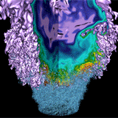
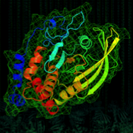
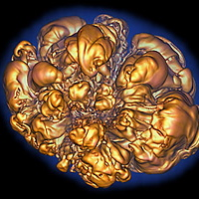


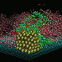


Partitioned Global Address Space Programming with Unified Parallel C (UPC) and UPC++
Kathy Yelick
Associate Laboratory Director for Computing Sciences
Lawrence Berkeley National Laboratory
EECS Professor, UC Berkeley

Slide 2
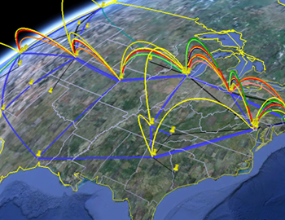

Computing Sciences at Berkeley Lab
Computing Sciences
ESnet Facility
NERSC Facility
Applied Math
Computer Science
Science Partnerships
Computational Research
Data Science
My research activity (UPC, DEGAS,..)

Slide 3
Parallel Programming Problem: Histogram
Consider the problem of computing a histogram:
Large number of “words” streaming in from somewhere
You want to count the # of words with a given property
In shared memory
Lock each bucket
A’s
B’s
C’s
…
Y’s
Z’s
Distributed memory: the array is huge and spread out
Each processor has a substream and sends +1 to the appropriate processor… and that processor “receives”
A’s
B’s
C’s
D’s
…
Y’s
Z’s

Slide 4
PGAS = Partitioned Global Address Space
Global address space: thread may directly read/write remote data
Convenience of shared memory
Partitioned: data is designated as local or global
Locality and scalability of message passing
x: 1
y:
x: 5
y:
x: 7
y: 0
Global address space
l:
l:
l:
g:
g:
g:
p0
p1
pn
Notes:
Too much time on this slide and next 3
Don’t talk about malloc
What about clusters of SMPs
Process, processor, thread
Too much talking relative to slide

Slide 5
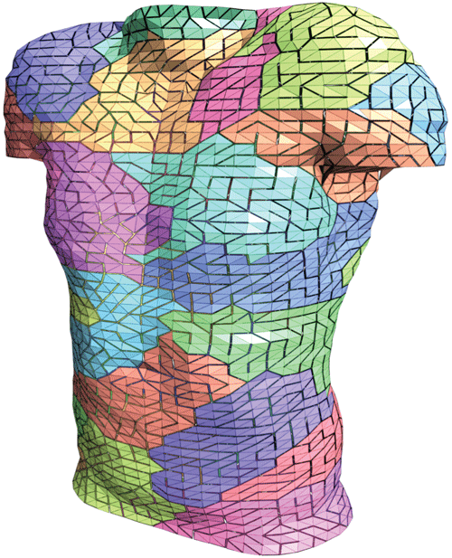
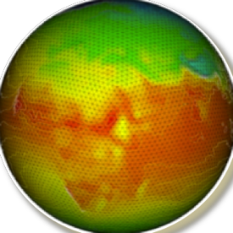
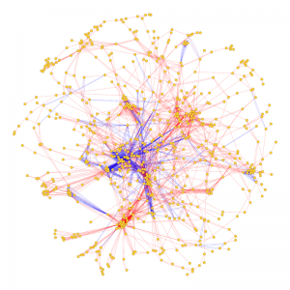
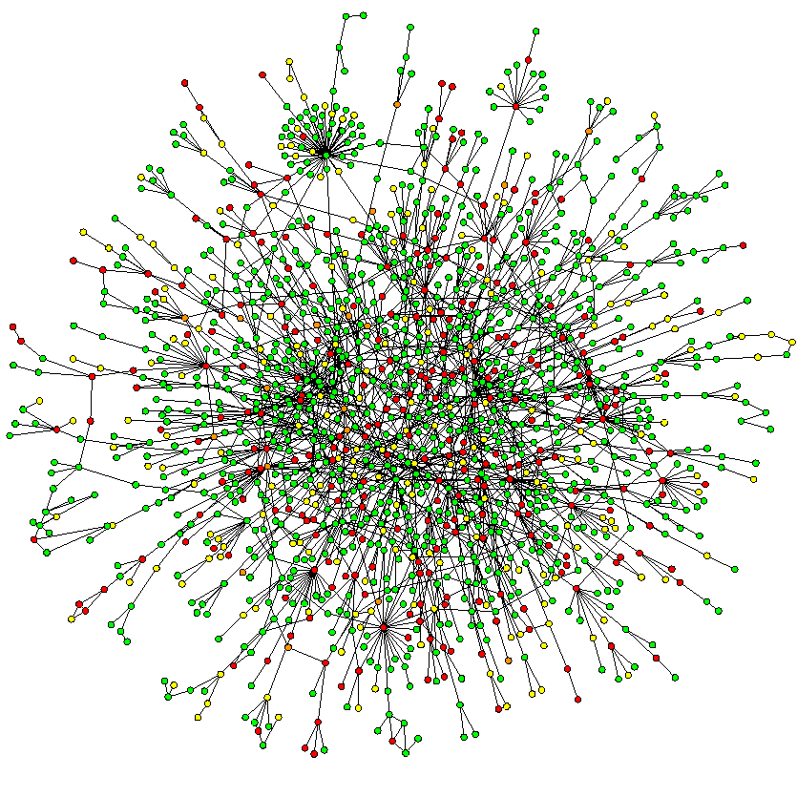
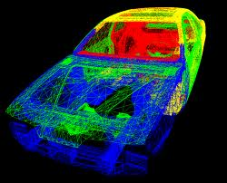
Programming Challenges and Solutions
Message Passing Programming
Divide up domain in pieces
Each compute one piece
Exchange (send/receive) data
PVM, MPI, and many libraries
Global Address Space Programming
Each start computing
Grab whatever you need whenever
Global Address Space Languages and Libraries
~10% of NERSC apps use some kind of PGAS-like model

Slide 6
Science Across the “Irregularity” Spectrum
Massive Independent Jobs for Analysis and Simulations
Nearest Neighbor Simulations
All-to-All Simulations
Random access, large data Analysis
Data analysis and simulation

Slide 7
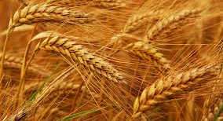

Low Overhead Atomic Updates Enable Genomics Assembly Grand Challenge
Meraculous assembler is used in production at the Joint Genome Institute
Wheat assembly is a “grand challenge”
Hardest part is contig generation (large in-memory hash table)
Meraculous Assembly Pipeline
reads
x
x
New fast I/O using SeqDB over HDF5
k-mers
New analysis filters errors using probabilistic “Bloom Filter”
contigs
Graph algorithm (connected components) scales to 15K cores on NERSC’s Edison
UPC
Gives tera- to petabtye “shared” memory
Combines with parallel I/O new genome mapping algorithm to anchor 92% of wheat chromosome
Human: 44 hours to 20 secs
Wheat: “doesn’t run” to 32 secs
Scaffolds using Scalable Alignment
Notes:
Wheat genome assembly is a grad challenge, only recently completely by two groups, one at JGI
The JGI code called Meraculous is used in production and is key to JGI.
Meraculous was partly parallelized before and was written in Perl, but the most challenging part of assembly (contig generation) had not been parallelized.
Contig generation is like putting together a puzzle, where you have fixed-length (K) sequences of the genome, called K-mers, and the goral is to created the longest possible chains, called contigs
The challenges to parallelization has been the need for random access into a large table that does not fit into shared memory hardware; the serial code was also very slow
The contig generation step has been entirely rewritten using DEGAS languages ideas, i.e., PGAS, with asynchronous communication and adaptive communication scheduluing to build and read a large shared hash table
Other parts of the pipline (k-mer analysis using bloom filters and better I/O) were also imlemented as part or other projects.
The work has just been accepted as an SC14 paper and a biology paper on this work was submitted to Nature Biotechnology
The biology groups have been able to do unprecedented genome assemblies using the high quality Meraculous algorithm)
The code would be much hardware to write in a traditional message passing style, i.e., it is so “unproductive” that it hadn’t been written for Meracuolous
Future work involves encapsulating the distirbuted data structures for both bloom filters and hash tables for use in other application, bioinformatics and otherwise
This is also an important workload to demonstrat that current petascale machines and future exascale ones can solve such irregular data-intensive computations

Slide 8
History of UPC
Initial Tech. Report from IDA in collaboration with LLNL and UCB in May 1999 (led by IDA).
Based on Split-C (UCB), AC (IDA) and PCP (LLNL)
UPC consortium participants (past and present) are:
ARSC, Compaq, CSC, Cray Inc., Etnus, GMU, HP, IDA CCS, Intrepid Technologies, LBNL, LLNL, MTU, NSA, SGI, Sun Microsystems, UCB, U. Florida, US DOD
UPC is a community effort, well beyond UCB/LBNL
Design goals: high performance, expressive, consistent with C goals, …, portable
UPC Today
Multiple vendor and open compilers (Cray, HP, IBM, SGI, gcc-upc from Intrepid, Berkeley UPC)
“Pseudo standard” by moving into gcc trunk
Most widely used on irregular / graph problems today

Slide 9
Bringing Users Along: UPC Experience
1991
Active Msgs are fast
Other GASNet-based languages
1993
Split-C funding (DOE)
2001
gcc-upc at Intrepid
2010
Hybrid MPI/UPC
1992
First AC (accelerators + split memory)
1997
First UPC Meeting
2001
First UPC Funding
2006
UPC in NERSC procurement
1992 First Split-C (compiler class)
“best of” AC, Split-C, PCP
2002 GASNet Spec
2003 Berkeley Compiler release
Ecosystem:
Users with a need (fine-grained random access)
Machines with RDMA (not full hardware GAS)
Common runtime; Commercial and free software
Sustained funding and Center procurements
Success models:
Adoption by users: vectors → MPI, Python and Perl, UPC/CAF
Influence traditional models: MPI 1-sided; OpenMP locality control
Enable future models: Chapel, X10,…

Slide 10
UPC Execution Model

Slide 11
UPC Execution Model
A number of threads working independently in a SPMD fashion
Number of threads specified at compile-time or run-time; available as program variable THREADS
MYTHREAD specifies thread index (0..THREADS-1)
upc_barrier is a global synchronization: all wait
There is a form of parallel loop that we will see later
There are two compilation modes
Static Threads mode:
THREADS is specified at compile time by the user
The program may use THREADS as a compile-time constant
Dynamic threads mode:
Compiled code may be run with varying numbers of threads

Slide 12
Hello World in UPC
Any legal C program is also a legal UPC program
If you compile and run it as UPC with P threads, it will run P copies of the program.
Using this fact, plus the a few UPC keywords:
#include <upc.h> /* needed for UPC extensions */
#include <stdio.h>
main() {
printf("Thread %d of %d: hello UPC world\n",
MYTHREAD, THREADS);
}

Slide 13
Example: Monte Carlo Pi Calculation
Estimate Pi by throwing darts at a unit square
Calculate percentage that fall in the unit circle
Area of square = r² = 1
Area of circle quadrant = ¼ * π r² = π/4
Randomly throw darts at x,y positions
If x² + y² < 1, then point is inside circle
Compute ratio:
# points inside / # points total
π = 4*ratio
r =1

Slide 14
Pi in UPC
Independent estimates of pi:
main(int argc, char **argv) {
int i, hits, trials = 0;
double pi;
if (argc != 2)trials = 1000000;
else trials = atoi(argv[1]);
srand(MYTHREAD*17);
for (i=0; i < trials; i++) hits += hit();
pi = 4.0*hits/trials;
printf("PI estimated to %f.", pi);
}
Each thread gets its own copy of these variables
Each thread can use input arguments
Initialize random in math library
Each thread calls “hit” separately

Slide 15
Helper Code for Pi in UPC
Required includes:
#include <stdio.h>
#include <math.h>
#include <upc.h>
Function to throw dart and calculate where it hits:
int hit(){
int const rand_max = 0xFFFFFF;
double x = ((double) rand()) / RAND_MAX;
double y = ((double) rand()) / RAND_MAX;
if ((x*x + y*y) <= 1.0) {
return(1);
} else {
return(0);
}
}

Slide 16
Shared vs. Private Variables

Slide 17
Private vs. Shared Variables in UPC
Normal C variables and objects are allocated in the private memory space for each thread.
Shared variables are allocated only once, with thread 0
shared int ours; // use sparingly: performance
int mine;
Shared variables may not have dynamic lifetime: may not occur in a function definition, except as static. Why?
Thread₀ Thread₁ Thread_{n}
ours:
Shared
Global address space
mine:
mine:
mine:
Private
Notes:
Thread 0 owns all shared scalar variables. Performance implications are clear, but if you don’t understand this, it’s easy to write slow UPC programs.
Why not allow shared scalar variables as automatic (non-static) variables within a function? Imagine what could happen if a shared variable were declared in a function. All threads calling that function could access the variable, but it might not exist at a given point in time.

Slide 18
Pi in UPC: Shared Memory Style
Parallel computing of pi, but with a bug
shared int hits;
main(int argc, char **argv) {
int i, my_trials = 0;
int trials = atoi(argv[1]);
my_trials = (trials + THREADS - 1)/THREADS;
srand(MYTHREAD*17);
for (i=0; i < my_trials; i++)
hits += hit();
upc_barrier;
if (MYTHREAD == 0) {
printf("PI estimated to %f.", 4.0*hits/trials);
}
}
shared variable to record hits
divide work up evenly
accumulate hits
What is the problem with this program?

Slide 19
Shared Arrays Are Cyclic By Default
Shared scalars always live in thread 0
Shared arrays are spread over the threads
Shared array elements are spread across the threads
shared int x[THREADS] /* 1 element per thread */
shared int y[3][THREADS] /* 3 elements per thread */
shared int z[3][3] /* 2 or 3 elements per thread */
In the pictures below, assume THREADS = 4
Blue elts have affinity to thread 0
Think of linearized C array, then map in round-robin
x
As a 2D array, y is logically blocked by columns
y
z
z is not

Slide 20
Pi in UPC: Shared Array Version
Alternative fix to the race condition
Have each thread update a separate counter:
But do it in a shared array
Have one thread compute sum
shared int all_hits [THREADS];
main(int argc, char **argv) {
… declarations an initialization code omitted
for (i=0; i < my_trials; i++)
all_hits[MYTHREAD] += hit();
upc_barrier;
if (MYTHREAD == 0) {
for (i=0; i < THREADS; i++) hits += all_hits[i];
printf("PI estimated to %f.", 4.0*hits/trials);
}
}
all_hits is shared by all processors, just as hits was
update element with local affinity

Slide 21
UPC Synchronization

Slide 22
UPC Global Synchronization
UPC has two basic forms of barriers:
Barrier: block until all other threads arrive
upc_barrier
Split-phase barriers
upc_notify; this thread is ready for barrier
do computation unrelated to barrier
upc_wait; wait for others to be ready
Optional labels allow for debugging
#define MERGE_BARRIER 12
if (MYTHREAD%2 == 0) {
...
upc_barrier MERGE_BARRIER;
} else {
...
upc_barrier MERGE_BARRIER;
}

Slide 23
Synchronization - Locks
Locks in UPC are represented by an opaque type:
upc_lock_t
Locks must be allocated before use:
upc_lock_t *upc_all_lock_alloc(void);
allocates 1 lock, pointer to all threads
upc_lock_t *upc_global_lock_alloc(void);
allocates 1 lock, pointer to one thread
To use a lock:
void upc_lock(upc_lock_t *l)
void upc_unlock(upc_lock_t *l)
use at start and end of critical region
Locks can be freed when not in use
void upc_lock_free(upc_lock_t *ptr);

Slide 24
Pi in UPC: Shared Memory Style
Like pthreads, but use shared accesses judiciously
shared int hits;
main(int argc, char **argv) {
int i, my_hits, my_trials = 0;
upc_lock_t *hit_lock = upc_all_lock_alloc();
int trials = atoi(argv[1]);
my_trials = (trials + THREADS - 1)/THREADS;
srand(MYTHREAD*17);
for (i=0; i < my_trials; i++)
my_hits += hit();
upc_lock(hit_lock);
hits += my_hits;
upc_unlock(hit_lock);
upc_barrier;
if (MYTHREAD == 0)
printf("PI: %f", 4.0*hits/trials);
}
one shared scalar variable
other private variables
create a lock
accumulate hits locally
accumulate across threads

Slide 25
Recap: Private vs. Shared Variables in UPC
We saw several kinds of variables in the pi example
Private scalars (my_hits)
Shared scalars (hits)
Shared arrays (all_hits)
Shared locks (hit_lock)
Thread₀ Thread₁ Thread_{n}
where:
n=Threads-1
hits:
hit_lock:
all_hits[0]:
all_hits[1]:
all_hits[n]:
Shared
Global address space
my_hits:
my_hits:
my_hits:
Private
Notes:
Thread 0 owns all shared scalar variables. Performance implications are clear, but if you don’t understand this, it’s easy to write slow UPC programs.
Why not allow shared scalar variables as automatic (non-static) variables within a function? Imagine what could happen if a shared variable were declared in a function. All threads calling that function could access the variable, but it might not exist at a given point in time.

Slide 26
UPC Collectives

Slide 27
UPC (Value-Based) Collectives
A portable library of collectives on scalar values (not arrays)
Example: x = bupc_allv_reduce(double, x, 0, UPC_ADD)
TYPE bupc_allv_reduce(TYPE, TYPE value, int root, upc_op_t op)
'TYPE' is the type of value being collected
root is the thread ID for the root (e.g., the source of a broadcast)
'value’ is both the input and output (must be a “variable” or l-value)
op is the operation: UPC_ADD, UPC_MULT, UPC_MIN, …
Computational Collectives: reductions and scan (parallel prefix)
Data movement collectives: broadcast, scatter, gather
Portable implementation available from:
http://upc.lbl.gov/download/dist/upcr_preinclude/bupc_collectivev.h
UPC also has more general collectives over arrays
http://upc.lbl.gov/docs/user/upc_spec_1.2.pdf

Slide 28
Pi in UPC: Data Parallel Style
The previous version of Pi works, but is not scalable:
On a large # of threads, the locked region will be a bottleneck
Use a reduction for better scalability
#include <bupc_collectivev.h>
// shared int hits;
main(int argc, char **argv) {
...
for (i=0; i < my_trials; i++)
my_hits += hit();
my_hits = // type, input, thread, op
bupc_allv_reduce(int, my_hits, 0, UPC_ADD);
// upc_barrier;
if (MYTHREAD == 0)
printf("PI: %f", 4.0*my_hits/trials);
}
Berkeley collectives
no shared variables
barrier implied by collective

Slide 29
UPC Collectives in General
The UPC collectives interface is in the language spec:
http://upc.lbl.gov/docs/user/upc_spec_1.2.pdf
It contains typical functions:
Data movement: broadcast, scatter, gather, …
Computational: reduce, prefix, …
Interface has synchronization modes:
Avoid over-synchronizing (barrier before/after is simplest semantics, but may be unnecessary)
Data being collected may be read/written by any thread simultaneously
Simple interface for collecting scalar values (int, double,…)
Berkeley UPC value-based collectives
Works with any compiler
http://upc.lbl.gov/docs/user/README-collectivev.txt

Slide 30
Full UPC Collectives
Value-based collectives pass in and return scalar values
But sometimes you want to collect over arrays
When can a collective argument begin executing?
Arguments with affinity to thread i are ready when thread i calls the function; results with affinity to thread i are ready when thread i returns.
This is appealing but it is incorrect: In a broadcast, thread 1 does not know when thread 0 is ready.
shared
0
1
2
local
dst
dst
dst
src
src
src
Slide source: Steve Seidel, MTU

Slide 31
UPC Collective: Sync Flags
In full UPC Collectives, blocks of data may be collected
A extra argument of each collective function is the sync mode of type upc_flag_t.
Values of sync mode are formed by or-ing together a constant of the form UPC_IN_XSYNC and a constant of the form UPC_OUT_YSYNC, where X and Y may be NO, MY, or ALL.
If sync_mode is (UPC IN_XSYNC | UPC OUT YSYNC), then if X is:
NO the collective function may begin to read or write data when the first thread has entered the collective function call,
MY the collective function may begin to read or write only data which has affinity to threads that have entered the collective function call, and
ALL the collective function may begin to read or write data only after all threads have entered the collective function call
and if Y is
NO the collective function may read and write data until the last thread has returned from the collective function call,
MY the collective function call may return in a thread only after all reads and writes of data with affinity to the thread are complete3, and
ALL the collective function call may return only after all reads and writes of data are complete.

Slide 32
Work Distribution Using upc_forall

Slide 33
Example: Vector Addition
Questions about parallel vector additions:
How to layout data (here it is cyclic)
Which processor does what (here it is “owner computes”)
/* vadd.c */
#include <upc_relaxed.h> #define N 100*THREADS shared int v1[N], v2[N], sum[N]; void main() { int i; for(i=0; i<N; i++)
if (MYTHREAD == i%THREADS) sum[i]=v1[i]+v2[i]; }
cyclic layout
owner computes

Slide 34
Work Sharing with upc_forall()
A common idiom:
Loop over all elements; work on those owned by this thread
UPC adds a special type of loop
upc_forall(init; test; loop; affinity)
statement;
Programmer indicates the iterations are independent
Undefined if there are dependencies across threads
Affinity expression indicates which iterations to run on each thread. It may have one of two types:
Integer: affinity%THREADS is MYTHREAD
Pointer: upc_threadof(affinity) is MYTHREAD
Syntactic sugar for:
for(i=0; i<N; i++) if (MYTHREAD == i%THREADS)
Compilers will sometimes do better than this, e.g.,
for(i=MYTHREAD; i<N; i+=THREADS)

Slide 35
Vector Addition with upc_forall
Vector addition can be written as follows
#define N 100*THREADS shared int v1[N], v2[N], sum[N]; void main() { int i; upc_forall(i=0; i<N; i++; i)
sum[i]=v1[i]+v2[i]; }
Cyclic data distribution default
Execute iff this is i^{th} thread (modulo # of threads)
The code would be correct but slow if the affinity expression were i+1 rather than i.
Equivalent code could use “&sum[i]” for affinity and would still work if you change the layout of sum

Slide 36
Distributed Arrays in UPC

Slide 37
Blocked Layouts in UPC
Array layouts are controlled by blocking factors:
Empty (cyclic layout)
[*] (blocked layout)
[b] (fixed block size)
[0] or [] (indefinite layout, all on 1 thread)
Vector addition example can be rewritten as follows using a cyclic or (maximally) blocked layout
#define N 100*THREADS shared int [*] v1[N], v2[N], sum[N]; void main() { int i; upc_forall(i=0; i<N; i++; &sum[i])
sum[i]=v1[i]+v2[i]; }
blocked layout

Slide 38
Layouts in General
All non-array objects have affinity with thread zero.
Array layouts are controlled by layout specifiers:
Empty (cyclic layout)
[*] (blocked layout)
[0] or [] (indefinite layout, all on 1 thread)
[b] or [b1][b2]…[bn] = [b1*b2*…bn] (fixed block size)
The affinity of an array element is defined in terms of:
block size, a compile-time constant
and THREADS.
Element i has affinity with thread
(i / block_size) % THREADS
In 2D and higher, linearize the elements as in a C representation, and then use above mapping

Slide 39
2D Array Layouts in UPC
Array a1 has a row layout and array a2 has a block row layout.
shared [m] int a1 [n][m];
shared [k*m] int a2 [n][m];
If (k + m) % THREADS = = 0 them a3 has a row layout
shared int a3 [n][m+k];
To get more general HPF and ScaLAPACK style 2D blocked layouts, one needs to add dimensions.
Assume r*c = THREADS;
shared [b1][b2] int a5 [m][n][r][c][b1][b2];
or equivalently
shared [b1*b2] int a5 [m][n][r][c][b1][b2];

Slide 40
Pointers to Shared vs. Arrays
In the C tradition, array can be access through pointers
Here is the vector addition example using pointers
#define N 100*THREADS
shared int v1[N], v2[N], sum[N];
void main() { int i; shared int *p1, *p2; p1=v1; p2=v2; for (i=0; i<N; i++, p1++, p2++ )
if (i %THREADS= = MYTHREAD) sum[i]= *p1 + *p2; }
v1
p1

Slide 41
UPC Pointers
Where does the pointer point?
 | Local | Global (to shared)
Private | p1 | p2
Shared | p3 | p4
Where does the pointer reside?
int *p1; /* private pointer to local memory */
shared int *p2; /* private pointer to shared space */
int *shared p3; /* shared pointer to local memory */
shared int *shared p4; /* shared pointer to
shared space */
Shared to local memory (p3) is not recommended.

Slide 42
UPC Pointers
Thread₀ Thread₁ Thread_{n}
p3:
p3:
p3:
p4:
p4:
p4:
Shared
Global address space
p1:
p1:
p1:
p2:
p2:
p2:
Private
int *p1; /* private pointer to local memory */
shared int *p2; /* private pointer to shared space */
int *shared p3; /* shared pointer to local memory */
shared int *shared p4; /* shared pointer to
shared space */
Pointers to shared often require more storage and are more costly to dereference; they may refer to local or remote memory.

Slide 43
Common Uses for UPC Pointer Types
int *p1;
These pointers are fast (just like C pointers)
Use to access local data in part of code performing local work
Often cast a pointer-to-shared to one of these to get faster access to shared data that is local
shared int *p2;
Use to refer to remote data
Larger and slower due to test-for-local + possible communication
int *shared p3;
Not recommended
shared int *shared p4;
Use to build shared linked structures, e.g., a linked list

Slide 44
UPC Pointers
In UPC pointers to shared objects have three fields:
thread number
local address of block
phase (specifies position in the block)
Example implementation
Phase is needed to implement p++ within/between threads
Virtual Address | Thread | Phase
Phase | Thread | Virtual Address
63
49
48
38
37
0

Slide 45
UPC Pointers
Pointer arithmetic supports blocked and non-blocked array distributions
Casting of shared to private pointers is allowed but not vice versa !
When casting a pointer-to-shared to a pointer-to-local, the thread number of the pointer to shared may be lost
Casting of shared to local is well defined only if the object pointed to by the pointer to shared has affinity with the thread performing the cast

Slide 46
Special Functions
size_t upc_threadof(shared void *ptr); returns the thread number that has affinity to the pointer to shared
size_t upc_phaseof(shared void *ptr); returns the index (position within the block)field of the pointer to shared
shared void *upc_resetphase(shared void *ptr); resets the phase to zero

Slide 47
Global Memory Allocation
shared void *upc_alloc(size_t nbytes);
nbytes : size of memory in bytes
Non-collective: called by one thread
The calling thread allocates a contiguous memory space in the shared space with affinity to itself.
shared [] double [n] p2 = upc_alloc(n&sizeof(double);
Thread₀ Thread₁ Thread_{n}
Global address space
Shared
n doubles
n doubles
n doubles
p2:
p2:
p2:
Private
void upc_free(shared void *ptr);
Non-collective function; frees the dynamically allocated shared memory pointed to by ptr

Slide 48
Global Memory Allocation
shared void *upc_all_alloc(size_t nblocks, size_t nbytes);
nblocks : number of blocks nbytes : block size
Collective: called by all threads together
Allocates a memory space in the shared space with the shape:
shared [nbytes] char[nblocks * nbytes]
All threads get the same pointer
shared void *upc_global_alloc(size_t nblocks, size_t nbytes);
Not collective
Each thread allocates its own space and receives a different pointer (to a different distributed block)
(Implementation challenges)

Slide 49
Distributed Arrays Directory Style
Many UPC programs avoid the UPC style arrays in factor of directories of objects
typedef shared [] double *sdblptr;
shared sdblptr directory[THREADS];
directory[i]=upc_alloc(local_size*sizeof(double));
directory
physical and conceptual 3D array layout
These are also more general:
Multidimensional, unevenly distributed
Ghost regions around blocks

Slide 50
Memory Consistency in UPC
The consistency model defines the order in which one thread may see another threads accesses to memory
If you write a program with unsychronized accesses, what happens?
Does this work?
data = … while (!flag) { };
flag = 1; … = data; // use the data
UPC has two types of accesses:
Strict: will always appear in order
Relaxed: May appear out of order to other threads
There are several ways of designating the type, commonly:
Use the include file:
#include <upc_relaxed.h>
Which makes all accesses in the file relaxed by default
Use strict on variables that are used as synchronization (flag)

Slide 51
Properties of UPC memory model
Definitions:
A data race is:
Two concurrent memory operations from two different threads to the same memory location in which at least one is a write.
A race-free program is one in which:
All executions of the program are free of data races (would be nice if the user could only worry about naïve implementations)
And states that programs will be sequentially consistent (behave as if all operations from each thread execute in order) if either of the following holds:
The program is race-free
The program contains no relaxed operations

Slide 52
Intuition on Strict Oderings
P₀
P₁
Each thread may “build” its own total order to explain behavior
They all agree on the strict ordering shown above in black, but
Different threads may see relaxed writes in different orders
Allows non-blocking writes to be used in implementations
Each thread sees own dependencies, but not those of other threads
Weak, but otherwise there would place consistency requirements on some relaxed operations (e.g., local cache control insufficient)
Preserving dependencies requires usual compiler/hw analysis

Slide 53
Synchronization- Fence
Upc provides a fence construct
Equivalent to a null strict reference, and has the syntax
upc_fence;
UPC ensures that all shared references issued before the upc_fence are complete

Slide 54
UPC Performance Features

Slide 55
UPC Compiler Implementation
UPC-to-C translator
UPC-to-object-code compiler
UPC code
UPC code
UPC source-to-source translator
UPC source-to-object-code complier
C code
Machine Instr.
Pros: portable, can use any backend C compiler
Cons: may lose program information between the two compilation phases
Example: Berkeley UPC
Pros: better for implementing UPC specific optimizations
Cons: less portable
Example: GCC UPC and most vendor UPC compilers

Slide 56
Exemplar Programming System Stack on Cray
Chapel
Apps
UPC Apps
CAF Apps
MPI Apps
Chapel
Compiler
BUPC Compiler
Chapel
Runtime
BUPC Runtime
Cray UPC Compiler
Cray CAF Compiler
Cray MPI / MPICH2
GASNet GNI Conduit
Cray PGAS Runtime
Cray Communication Libraries (DMAPP/GNI)
Cray Networks (Gemini/Aries)

Slide 57
Berkeley UPC Software Stack
Hardware Dependant
UPC Applications
Language Dependant
UPC-to-C Translator
C code with Runtime Calls
UPC Runtime
GASNet Communication Library
Network and OS API
Tip: you can choose your favorite C compiler (e.g., clang, icc, gcc, nvcc, xlc) as the backend compiler with BUPC.
Notes:
Portable and High Performance
Language independent, hardware portable

Slide 58
GASNet Software Stack
PGAS Programming Systems (e.g., BUPC, CAF 2.0, Chapel, OpenSHMEM, Titanium, and DEGAS)
GASNet
Active Messages
One-sided Communication
Collective Communication
Low-level communication APIs (e.g., Cray GNI, IBM PAMI, IB Verbs, Portals 4, UDP, shared-memory)
Interconnect

Slide 59
Implementing UPC Shared Data Access
shared int s;
s= 5;
UPC-to-C Translator
UPCR_PUT_PSHARED_VAL(s, 0, 5, 4);
Runtime Address Translation Overheads
UPC Runtime
Remote
Local
Where is “s”?
GASNet
Local Memory operation
Tip: try “upcc –trans test.upc” to see the translated C code for Berkeley UPC.

Slide 60
When Address Translation Overheads Matter?
Case 2: access remote data
Case 1: access local data
Get the partition id of the global address (1 cycle)
Check if the partition is local (1 cycle)
Get the local address of the partition (1 cycle)
Access data through the local address (1 cycle)
3 CPU cycles for address translation vs. 1 cycle for real work
(Bad: 3X overhead)
Get the partition id of the global address (1 cycle)
Check if the partition is local (1 cycle)
Get the local address of the partition (1 cycle)
Access data through the network (~10⁴ cycles)
3 CPU cycles for address translation vs. ~10⁴ cycles for real work
(Good: 0.3% overhead)

Slide 61
Performance: Pointer-to-local vs. Pointer-to-shared
Good
Tip: Cast a pointer-to-shared to a regular C pointer for accessing the local portion of a shared object. E.g., int *p = (int *)pts; p[0] = 1;

Slide 62
How to Amortize Address Translation Overheads
Move data in chunks
upc_mem(cpy|put|get)(…)
non-blocking upc_mem(cpy|put|get) are even better
Cast pointer-to-shared to pointer-to-local
#include<upc_castable.h> // in UPC 1.3
void *upc_cast(const shared void *ptr);
T1
T2
Thread 1’s perspective
shared int *sp1
Tip: UPC 1.3 enables you to cast a pointer-to-shared with affinity to another UPC thread to a pointer-to-local if both threads share the same physical node.
shared int *sp2
UPC 1.2
int *p1 = (int *)sp1;
UPC 1.3
int *p2 = upc_cast(sp2);
Physical Shared-memory
Virtual Address Space
Notes:
UPC 1.2 only supports casting pointers with affinity to the calling UPC thread
UPC 1.3 supports casting pointers with affinity to any UPC thread in the same shared-memory node

Slide 63
Non-blocking Memcpy is crucial to performance
Hardware can reorder operations to improve performance (e.g., network adaptive routing), but possible data dependencies may prohibit it.
Src Node
put 1 to *p1
These two Put operations may be completed out-of-order iff p1 and p2 are different addresses.
put 2 to *p2
By using non-blocking memcpy, the user gives the permission to complete memory operations in arbitrary order.
Dst Node
Notes:
Because the compiler often can’t tell whether p1 and p2 are aliases, it would instruct the runtime to perform these two operations in program order, which is conservatively correct but loses performance.

Slide 64
UPC 1.3 Non-blocking Memcpy
#include<upc_nb.h>
upc_handle_t h =
upc_memcpy_nb(shared void * restrict dst,
shared const void * restrict src,
size_t n);
void upc_sync(upc_handle_t h); // blocking wait
int upc_sync_attempt(upc_handle_t h); // non-blocking
// Implicit handle version, no handle management by user
void upc_memcpy_nbi(…); // parameters the same as upc_memcpy
void upc_synci(); // sync all issued implicit operations
int upc_sync_attempti(); // test the completion status of
// implicit operations

Slide 65
UPC 1.3 Atomic Operations
More efficient than using locks when applicable
Hardware support for atomic operations are available, but
upc_lock();
update();
upc_unlock();
vs
atomic_update();
Only support limited operations on a subset of data types. e.g.,
Atomic ops from different processors may not be atomic to each other
Atomic_CAS on uint64_t
CPU
Memory
GPU
Memory
Atomic_Add on double
NIC
Notes:
The UPC Atomic Memory Operations library introduces an atomicity domain, an object that specifies a single operand type and a set of operations over which access to a memory location in a given synchronization phase is guaranteed to be atomic if and only if no other mechanisms or atomicity domains are used to access the same memory location in the same synchronization phase.

Slide 66
UPC 1.3 Atomic Operations (cont.)
Key new idea: atomicity domain
Users specify the operand data type and the set of operations over which atomicity is needed
// atomicity domain for incrementing 64-bit integers
upc_atomicdomain_t *domain =
upc_all_atomicdomain_alloc(UPC_INT64, UPC_INC, 0);
upc_atomic_strict(upc_atomicdomain_t *domain,
void * restrict fetch_ptr,
upc_op_t op,
shared void * restrict target,
const void * restrict operand1,
const void * restrict operand2);
upc_atomic_relaxed(…); // relaxed consistency version
Notes:
#include <upc_atomic.h>

Slide 67
Performance of UPC

Slide 68
Berkeley UPC Compiler
UPC Code
UPC Compiler
Used by bupc and gcc-upc
Platform- independent
Compiler-generated C code
Network- independent
UPC Runtime system
Compiler- independent
GASNet Communication System
Language- independent
Used by Cray UPC, CAF, Chapel, Titanium, and others
Network Hardware

Slide 69
PGAS Languages have Performance Advantages
Strategy for acceptance of a new language
Make it run faster than anything else
Keys to high performance
Parallelism:
Scaling the number of processors
Maximize single node performance
Generate friendly code or use tuned libraries (BLAS, FFTW, etc.)
Avoid (unnecessary) communication cost
Latency, bandwidth, overhead
Berkeley UPC and Titanium use GASNet communication layer
Avoid unnecessary delays due to dependencies
Load balance; Pipeline algorithmic dependencies

Slide 70
One-Sided vs Two-Sided
one-sided put message
host
CPU
address
data payload
network
interface
two-sided message
memory
message id
data payload
A one-sided put/get message can be handled directly by a network interface with RDMA support
Avoid interrupting the CPU or storing data from CPU (preposts)
A two-sided messages needs to be matched with a receive to identify memory address to put data
Offloaded to Network Interface in networks like Quadrics
Need to download match tables to interface (from host)
Ordering requirements on messages can also hinder bandwidth

Slide 71
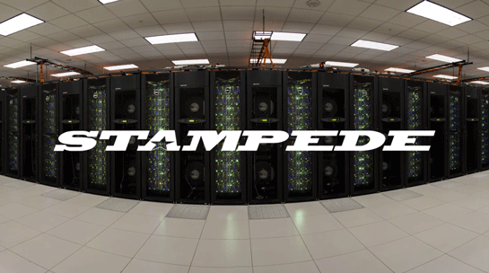
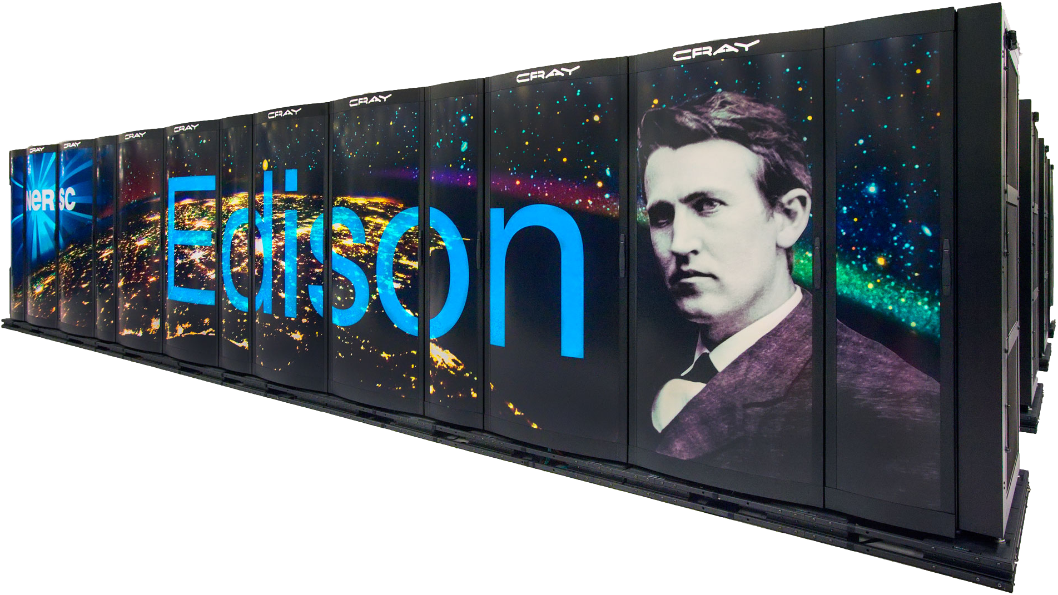
Why Should You Care about PGAS?
better
Notes:
OSU MPI/UPC benchmark suite 4.3.1
impi/4.1.0.030 on Stampede
Light-weight cores are more sensitive to overheads
Smaller per-core memory results in more frequent communication

Slide 72
Bandwidths on Cray XE6 (Hopper)

Slide 73
One-Sided vs. Two-Sided: Practice
NERSC Jacquard machine with Opteron processors
(up is good)
InfiniBand: GASNet vapi-conduit and OSU MVAPICH 0.9.5
Half power point (N ½ ) differs by one order of magnitude
This is not a criticism of the implementation!
Joint work with Paul Hargrove and Dan Bonachea
Notes:
Reduce text at bottom of slides and improve claris
Make nested graph more readable
Use “MVAPICH” not just OSU MPI
AMRCI allows ordering; GASnet is at HW RDMA BW
Define RDMA

Slide 74
GASNet: Portability and High-Performance
(down is good)
GASNet better for latency across machines
Joint work with UPC Group; GASNet design by Dan Bonachea
Notes:
Remove Altix data or explain better
explain axes
significant benefit to targetting the lower-level API - MPI is not always the best choice

Slide 75
GASNet: Portability and High-Performance
(up is good)
GASNet at least as high (comparable) for large messages
Joint work with UPC Group; GASNet design by Dan Bonachea
Notes:
Generally meet or exceed what MPI can provide
vapi deviation - firmware perf bug
altix - single vs two copy?

Slide 76
GASNet: Portability and High-Performance
(up is good)
GASNet excels at mid-range sizes: important for overlap
Joint work with UPC Group; GASNet design by Dan Bonachea
Notes:
LAPI and VAPI increase B/W relative to MPI
Generally meet or exceed what MPI can provide

Slide 77
Communication Strategies for 3D FFT
chunk = all rows with same destination
Three approaches:
Chunk:
Wait for 2nd dim FFTs to finish
Minimize # messages
Slab:
Wait for chunk of rows destined for 1 proc to finish
Overlap with computation
Pencil:
Send each row as it completes
Maximize overlap and
Match natural layout
pencil = 1 row
slab = all rows in a single plane with same destination
Joint work with Chris Bell, Rajesh Nishtala, Dan Bonachea
Notes:
Rearrange this slide; need a picture

Slide 78
Overlapping Communication
Goal: make use of “all the wires all the time”
Schedule communication to avoid network backup
Trade-off: overhead vs. overlap
Exchange has fewest messages, less message overhead
Slabs and pencils have more overlap; pencils the most
Example: Class D problem on 256 Processors
Exchange (all data at once) | 512 Kbytes
Slabs (contiguous rows that go to 1 processor) | 64 Kbytes
Pencils (single row) | 16 Kbytes
Joint work with Chris Bell, Rajesh Nishtala, Dan Bonachea
Notes:
Merge with earlier slide
Make clear that nonblocking availabe in MPI too

Slide 79
NAS FT Variants Performance Summary
.5 Tflops
Slab is always best for MPI; small message cost too high
Pencil is always best for UPC; more overlap
Joint work with Chris Bell, Rajesh Nishtala, Dan Bonachea
Notes:
Remote “long message matching queue depths”
MPI point less negative

Slide 80
FFT Performance on BlueGene/P
UPC implementation consistently outperform MPI
Uses highly optimized local FFT library on each node
UPC version avoids send/receive synchronization
Lower overhead
Better overlap
Better bisection bandwidth
Numbers are getting close to HPC record on BG/P
HPC Challenge Peak as of July 09 is ~4.5 Tflops on 128k Cores
G
O
O
D

Slide 81
FFT Performance on Cray XT4
1024 Cores of the Cray XT4
Uses FFTW for local FFTs
Larger the problem size the more effective the overlap
G
O
O
D

Slide 82
Event Driven LU in UPC
DAG Scheduling before it’s time
Assignment of work is static; schedule is dynamic
Ordering needs to be imposed on the schedule
Critical path operation: Panel Factorization
General issue: dynamic scheduling in partitioned memory
Can deadlock in memory allocation
“memory constrained” lookahead
some edges omitted

Slide 83
UPC HPL Performance
MPI HPL numbers from HPCC database
Large scaling:
2.2 TFlops on 512p,
4.4 TFlops on 1024p (Thunder)
Comparison to ScaLAPACK on an Altix, a 2 x 4 process grid
ScaLAPACK (block size 64) 25.25 GFlop/s (tried several block sizes)
UPC LU (block size 256) - 33.60 GFlop/s, (block size 64) - 26.47 GFlop/s
n = 32000 on a 4x4 process grid
ScaLAPACK - 43.34 GFlop/s (block size = 64)
UPC - 70.26 Gflop/s (block size = 200)
Joint work with Parry Husbands

Slide 84
MILC (QCD) Performance in UPC
MILC is Lattice Quantum Chromo-Dynamics application
UPC scales better than MPI when carefully optimized

Slide 85
Communication Overlap Complements Avoidance
Even with communication-optimal algorithms (minimized bandwidth) there are still benefits to overlap and other things that speed up networks
Communication Avoiding and Overlapping for Numerical Linear Algebra, Georganas et al, SC12

Slide 86
Summary
UPC designed to be consistent with C
Ability to use pointers and arrays interchangeably
Designed for high performance
Memory consistency explicit; Small implementation
Transparent runtime
gcc version of UPC:
http://www.gccupc.org/
Berkeley compiler
http://upc.lbl.gov
Language specification and other documents
https://code.google.com/p/upc-specification
https://upc-lang.org
Vendor compilers: Cray, IBM, HP, SGI,…

Slide 87
Application Development in UPC

Slide 88
Topics
Starting a project
Choosing the right SDK
Interoperability with other programming models
OpenMP, MPI, CUDA…
Shared memory programming
Data layout and allocation
Computational efficiency (“serial” performance
Synchronization
Managing parallelism – data parallel & dynamic tasking
UPC and OpenMP

Slide 89
Topics (2)
Distributed memory programming
UPC and MPI
Tuning communication performance
Hybrid parallelism

Slide 90
UPC SDKs
Multiple SDKs are available
Portable
BUPC provided by LBL is portable – available at http://upc.lbl.gov
GUPC provided by Intrepid, gcc based, portable, uses BUPC runtime
Vendor SDKs – Cray UPC XT/XE
UPC has been shown to interoperate with
MPI, OpenMP, CUDA, Intel TBB, Habanero-C
Any pthreads based libray e.g. MKL
Some interoperability aspects are implementation specific, e.g. who owns main()
E.g. http://upc.lbl.gov/docs/user/interoperability.shtml

Slide 91
Shared Memory Programming

Slide 92
Shared Memory Programming
Performance determined by
Locality – placement, data initialization
Computational efficiency
Synchronization performance
Management of parallelism
When should memory be shared (shared) ?
When should memory be blocked (shared []) ?

Slide 93
Pointer Arithmetic and Data Placement
Memory is allocated with upc_alloc, upc_all_alloc with affinity to a certain thread
The pointer type determines the address arithmetic rules and the “locality” of access
shared double *p1;
shared [*] double *ps;
shared [] double *pi;
for(i=0; i < N; i++) {
p1[i] = i;
ps[i] = i;
pi[i] = i;
}
1 | 3
2 | 4
1 | 2
3 | 4
1 | 2 | 3 | 4

Slide 94
2-D Stencil – Laplace Filter – block cyclic
shared double matrix[ROWS][COLS];
…
main() {
for(i=0; i < ROWS; i++)
for(j = 0; ; j < COLS; j++) {
up = (i == 0) ? 0 : matrix[i-1][j];
down = (i == ROWS-1) ? 0 : matrix[i+1][j];
left = (j == 0) ? 0 : matrix[i][j-1];
right = (j == COLS - 1) ? 0 : matrix[i][j+1];
tmp[i][j] = 4 * matrix[i][j] - up - down - left - right;
}
Block cyclic layout easy to choose when porting codes, bad for locality

Slide 95
2-D Stencil – Laplace Filter – block layout
shared [*] double matrix[ROWS][COLS];
…
main() {
for(i=0; i < ROWS; i++)
for(j = 0; ; j < COLS; j++) {
up = (i == 0) ? 0 : matrix[i-1][j];
down = (i == ROWS-1) ? 0 : matrix[i+1][j];
left = (j == 0) ? 0 : matrix[i][j-1];
right = (j == COLS - 1) ? 0 : matrix[i][j+1];
tmp[i][j] = 4 * matrix[i][j] - up - down - left - right;
}
Blocked layout easy to choose when porting codes, good for locality,
code not portable

Slide 96
2-D Stencil – Laplace Filter – directory
typedef shared [] double * SDPT;
shared SDPT matrix[ROWS];
SDPT local_dir[ROWS];
…
main() {
..matrix[my_row] = upc_alloc(..); //allocate ptrs to rows
upc_barrier;
..local_dir[i] = matrix[i]; //local copies of dir entries
for(i=0; i < ROWS; i++)
for(j = 0; ; j < COLS; j++) {
up = (i == 0) ? 0 : local_dir[i-1][j];
..right = (j == COLS - 1) ? 0 : local_dir[i][j+1];
tmp[i][j] = 4 * local_dir[i][j] - up - down - left - right;
}
Directory based approach provides locality and portability

Slide 97
Computational Efficiency
(ALWAYS Cast to C)

Slide 98
Computational Intensity – ALWAYS cast to C
Good
Cast a pointer-to-shared to a regular C pointer for accessing the local portion of a shared object.
E.g., int *p = (int *)pts; p[0] = 1;

Slide 99
Application Examples

Slide 100
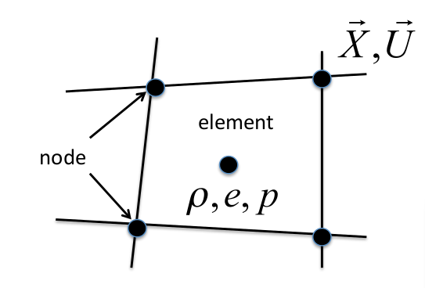
LULESH - https://codesign.llnl.gov/lulesh.php
Livermore Unstructured Lagrangian Explicit Shock Hydrodynamics
Models explicit hydrodynamics portion of ALE3D
Particular application is a Sedov blast wave problem
Used to explore various programming models, e.g. Charm++, Chapel, Loci, Liszt
Solves equations on a staggered 3D spatial mesh
Most communication is nearest neighbor on a hexahedral 3D grid

Slide 101
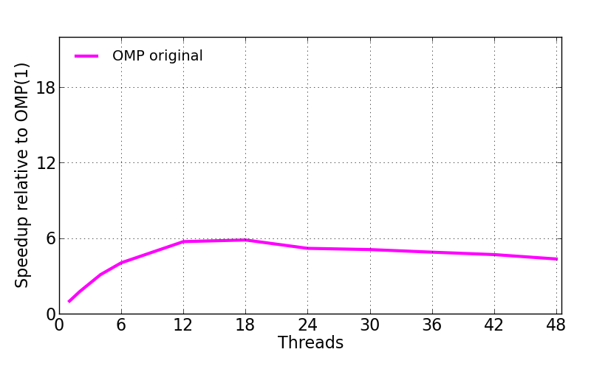
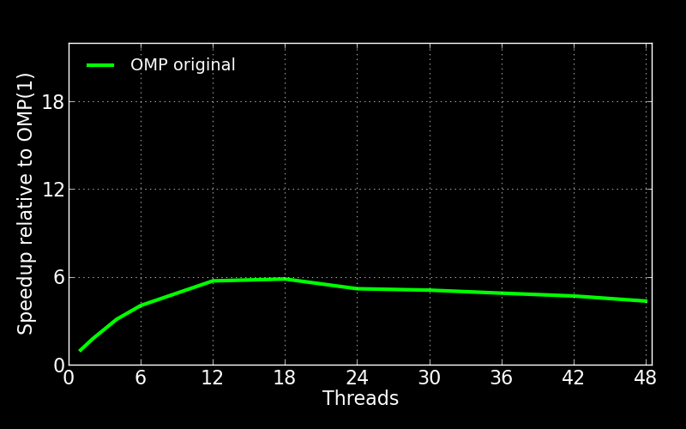
LULESH OMP
Doesn’t scale beyond 12 cores (2 NUMA nodes)

Slide 102
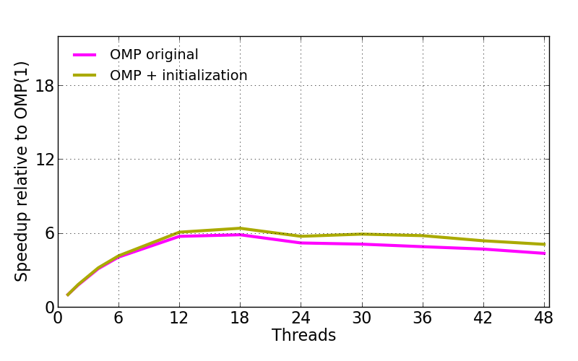
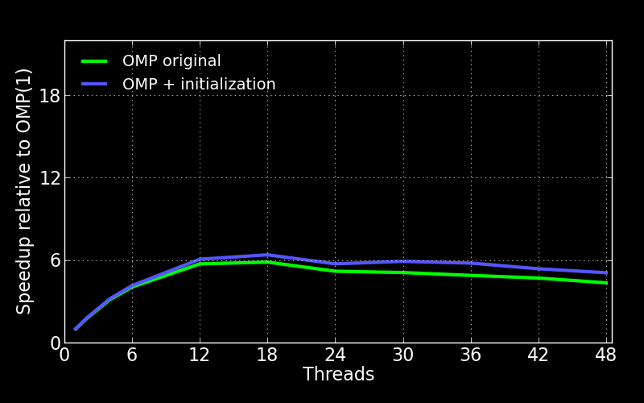
LULESH OMP Parallel Initialization
Parallel initialization helps only slightly
Still doesn’t scale beyond 18 cores
Uses temporary arrays with malloc and free in many calls

Slide 103
LULESH OpenMP to UPC
LULESH authors advise:
“Do not make simplifications”
None-the-less, I made some simplifications:
Primarily for readability and clarity
Why follow certain impl. choices? (e.g. temp arrays)
Performance improvements in UPC at scale
Primarily due to locality management, not simplifications
UPC with one thread is slower than C++ serial
Best UPC 298s, best C++ serial 283s

Slide 104
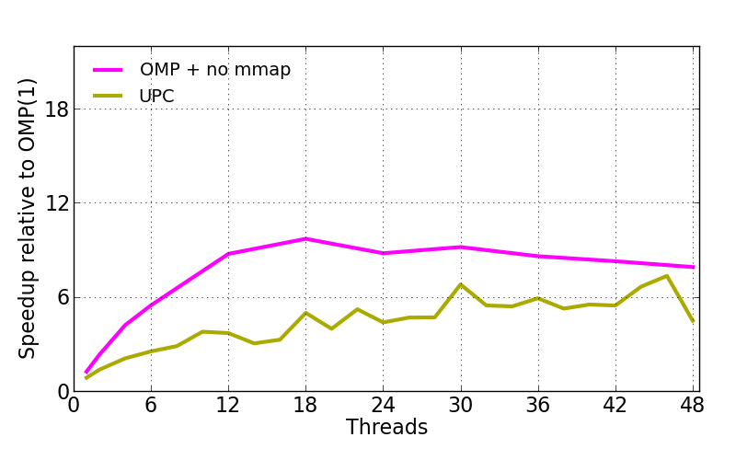
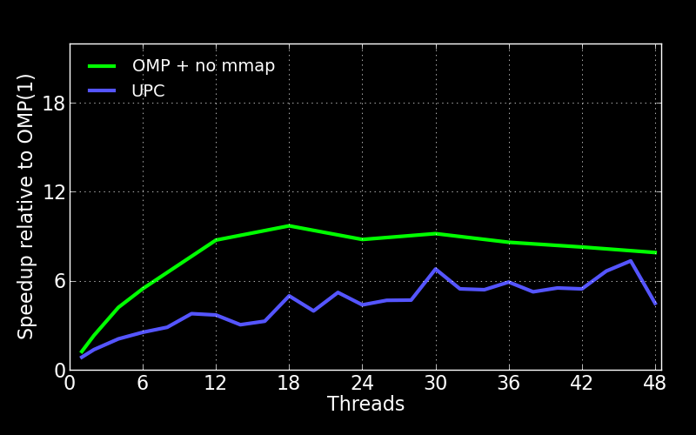
LULESH Naïve UPC – block cyclic distribution
Shared arrays distributed cyclically (default)
Replicate data to make it private where possible
Poor compared to OMP

Slide 105
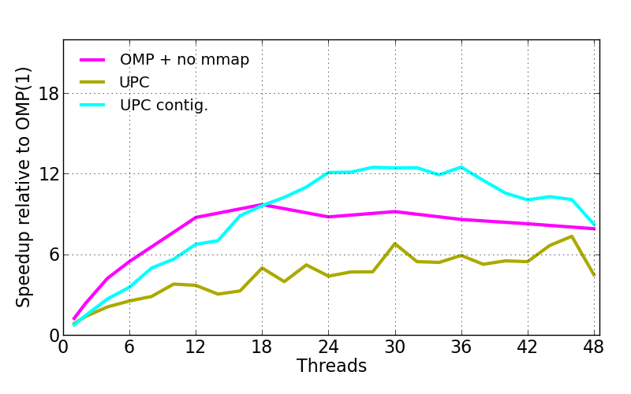
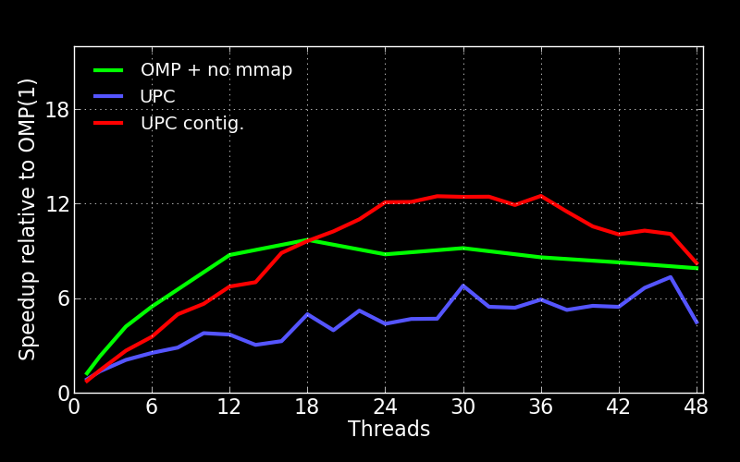
LULESH UPC Blocked Memory Layout
Cyclic layout poor fit for communication pattern
Contiguous layout (blocked) reduces communication
shared [*] double x[N * THREADS];

Slide 106
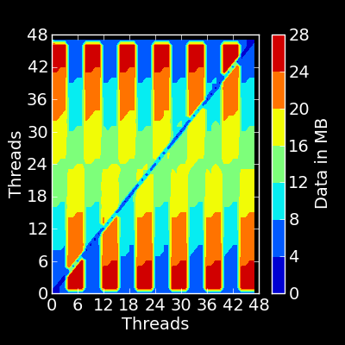
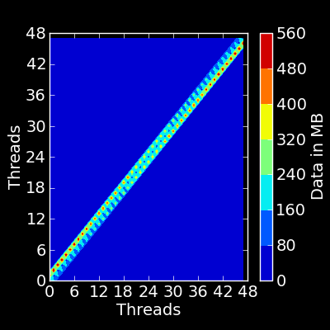
LULESH UPC Communication
Cyclic layout Contiguous layout

Slide 107
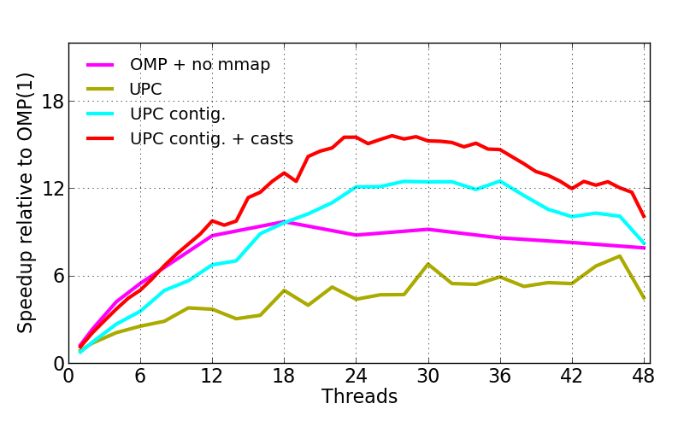
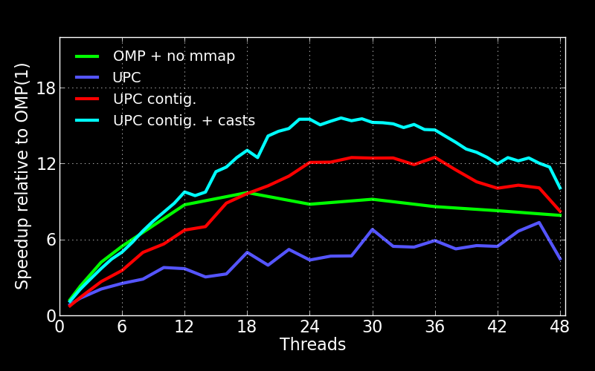
LULESH UPC Cast Shared to Private
Use private pointer to the thread block in shared array
double* my_x = (double*)(x + MYTHREAD * BSIZE)

Slide 108
XSBench - Embarrassingly parallel
Monte Carlo simulation of paths of neutrons traveling across a reactor core
85% of runtime in calculation of macroscopic neutron cross sections
random_sample
binary_search
for each nuclide
lookup_bounding_micro_xs
interpolate
accumulate_macro_xs
Uses a lot of memory

Slide 109
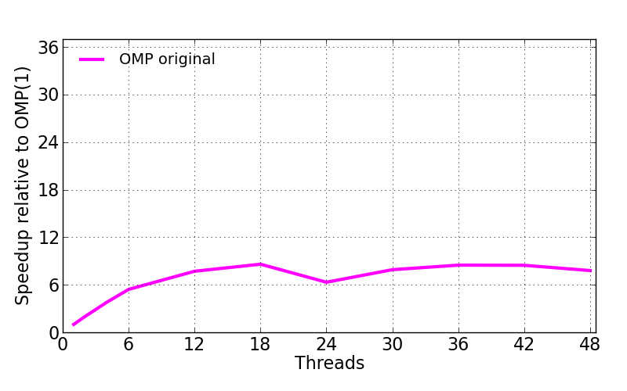
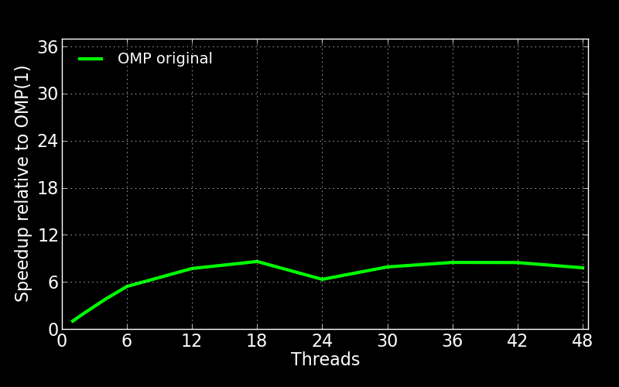
XSBench OMP Doesn’t Scale
Option to add flops; according to README:
“Adding flops has so far shown to increase scaling, indicating that there is in fact a bottleneck being caused by the memory loads”

Slide 110
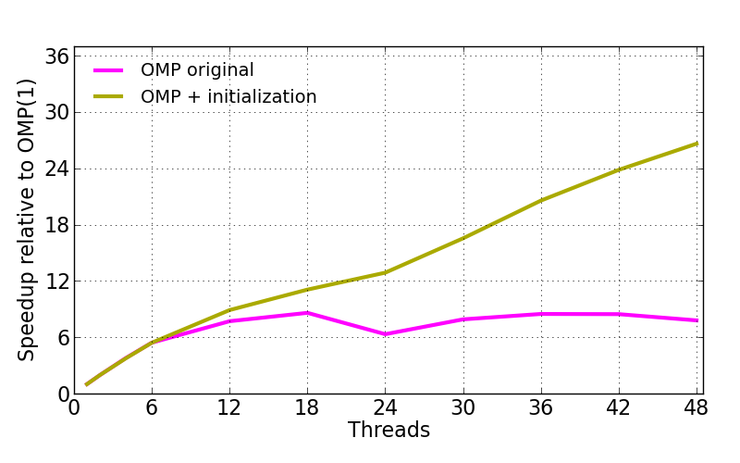
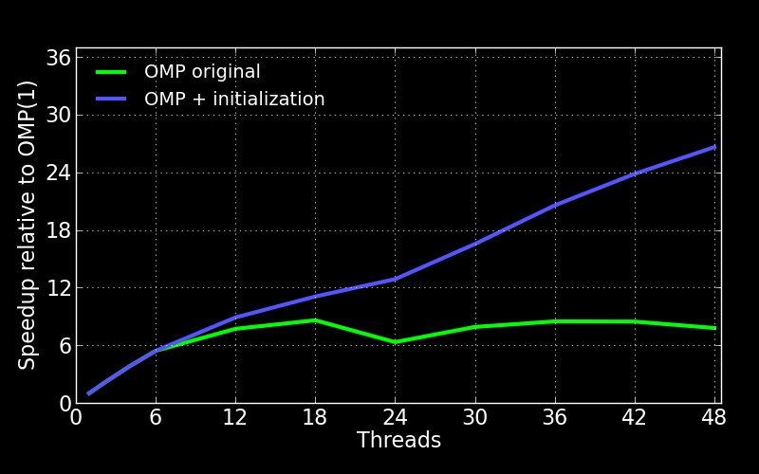
XSBench OMP Initialization
But memory locality is the problem (on NUMA)
Adding parallel initialization makes it scale

Slide 111
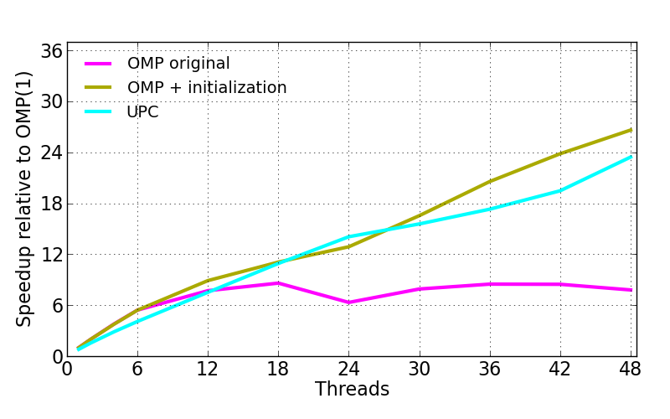
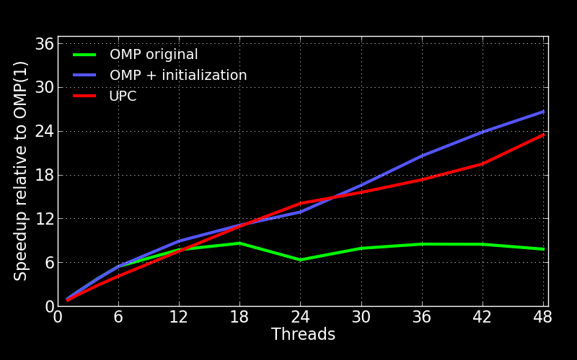
XSBench UPC
Private replication of data
Except: make largest memory array shared

Slide 112
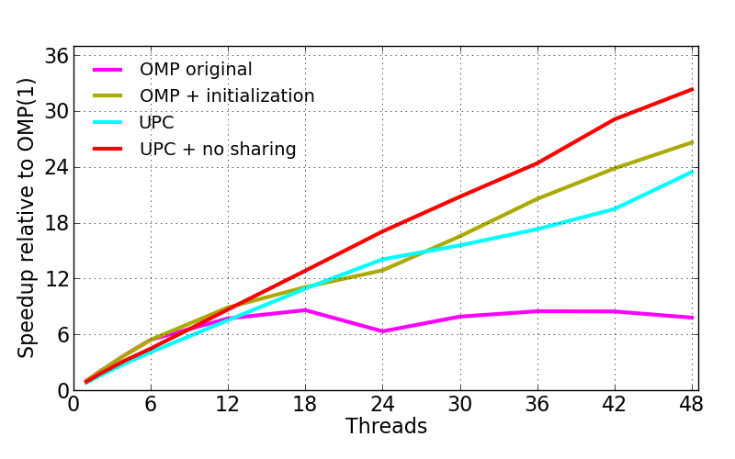
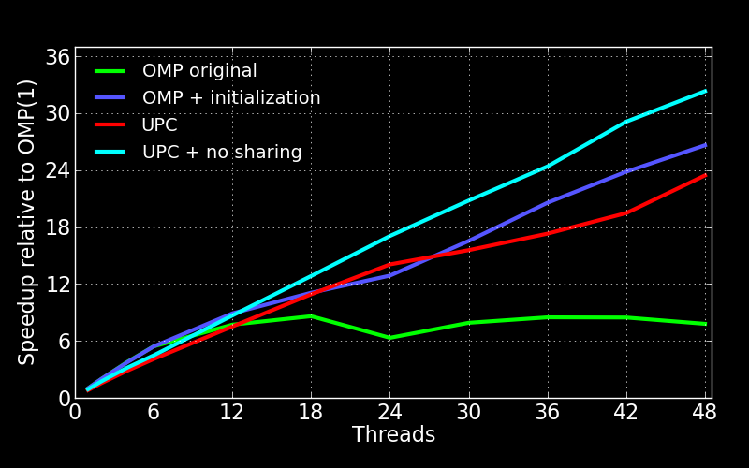
XSBench UPC No Shared Memory
Improves if all memory is private
Can’t do for large problems, e.g. 355 isotopes requires 60GB for full replication on 48 cores
Notes:
Overhead comes from sharing, not from parallel regions (openmp vs pc)

Slide 113
Synchronization Performance

Slide 114
Barriers, locks, atomics, collectives….
OpenMP provides an implicit model of synchronization
The UPC language provides rich synchronization primitives
e.g. UPC 1.3 atomics
Some are well optimized for multicore performance
“Optimizing Collective Communication on Multicore”. Nishtala&Yelick, HotPart’09
In general, UPC synchronization performs much better than OpenMP synchronization or other pthreads based libraries (implementation does matter)
#pragma omp critical
-> bupc_allv_reduce_all()

Slide 115
LULESH UPC Procs vs Pthreads
At 48 cores, pthreads takes 33s, processes only 22s
Top non-app code functions with pthreads:
upcr_wait_internal 15% (barrier)
gasnete_coll_broadcast 2%
gasnete_coll_gather 2%
Top non-app code functions with pinned procs:
gasnete_pshmbarrier_wait 5%
For comparison, collectives with pinned procs:
gasnete_coll_broadcast 0.2% (15x)
gasnete_coll_gather 0.04% (75x)

Slide 116
Lessons Learned
On a large NUMA system, managing remote memory access is key
Good preparation for distributed memory?
UPC
Contiguous blocking is effective at reducing communication
Explicitly cast to private whenever possible
Procs can be significantly faster than pthreads
Hybrid PGAS Runtime Support for Multicore Nodes
Blagojevic, Hargrove, Iancu, Yelick. PGAS 2010
Replication to private can help, but limited by available memory -> replicate fixed amount?

Slide 117
Managing Parallelism

Slide 118
Managing Parallelism
Data parallel constructs in UPC – upc_forall
SPMD, shorthand for filtering the computation performed by a task
Not real equivalent of #pragma omp for..
Task parallelism in OMP: #pragma omp task
UPC tasking library – available at http://upc.lbl.gov
Written in stock UPC, works on
shared memory - comparable to OpenMP tasking
distributed memory – akin to Charm++
Provides:
Init, termination
Locality aware distributed work-stealing
Synchronization for dependent task graphs

Slide 119
Task Library API
taskq_t *taskq_all_alloc(int nFunc, void *func1, int input_size1, int output_size1, ...);
int taskq_put(taskq_t *taskq, void *func, void *in, void *out);
int taskq_execute(taskq_t *taskq);
int taskq_steal(taskq_t *taskq);
void taskq_wait(taskq_t *taskq);
void taskq_fence(taskq_t *taskq);
int taskq_all_isEmpty(taskq_t *taskq);
Hierarchical Work Stealing on Manycore Clusters Min, Iancu,Yelick. PGAS 2011

Slide 120
UPC Task Library – Shared Memory

Slide 121
UPC Task Library – Distributed Memory

Slide 122
Distributed Memory Programming

Slide 123
UPC and MPI
Send/Recv carry both data and synchronization
One-sided carries only data
When porting codes from MPI two-sided to one sided, a Send/Recv pair needs to be replaced with Put/Get and producer-consumer semantics
There are also performance differences
UPC can saturate the network with fewer cores active per node
It alleviates the need for packing messages

Slide 124
Cray XE6 BW Saturation (hopper @ NERSC)

Slide 125
Cray XE6 Application Performance

Slide 126
Tuning Communication Performance

Slide 127
UPC Trends
In MPI, large messages or large message concurrency (messages per core, ranks per node) is required for performance
In UPC, communication overlap is beneficial
with other communication
with other computation
In UPC:
Pays to think about increasing the message concurrency
Sometimes need to take care to avoid congestion
Congestion Avoidance on Manycore HPC Systems
Luo, Panda, Ibrahim, Iancu. ICS’12
Again, avoiding pthreads improves performance

Slide 128
Saturation IB
Messages > 8K benefit
from throttling
Messages < 1024
benefit from concurrent
injection

Slide 129
Throughput and Message Concurrency
Limiting the number of outstanding messages
provides 5X speedup (expected 32X slower)
Cray UPC on Cray XE6 (Gemini)

Slide 130
When To Use It?
With irregular parallelism with “natural small messages”
When hybrid parallelism makes packing complex
Need to mix with pthreads based libraries and want to perform communication from within pthreads
Implementation specific, but available
Do not want to worry about matching communication concurrency to intra-node concurrency…
Challenges:
Exporting data, do not want to modify data structures
One-sided is different, need to understand it…

Slide 131
Beyond UPC

Slide 132

DEGAS Programming System: UPC++
UPC++
A template-based programming system enabling PGAS features for C++ applications
DEGAS is a DOE-funded X-Stack project led by Lawrence Berkeley National Lab (PI: Kathy Yelick), in collaboration with LLNL, Rice Univ., UC Berkeley, and UT Austin.

Slide 133
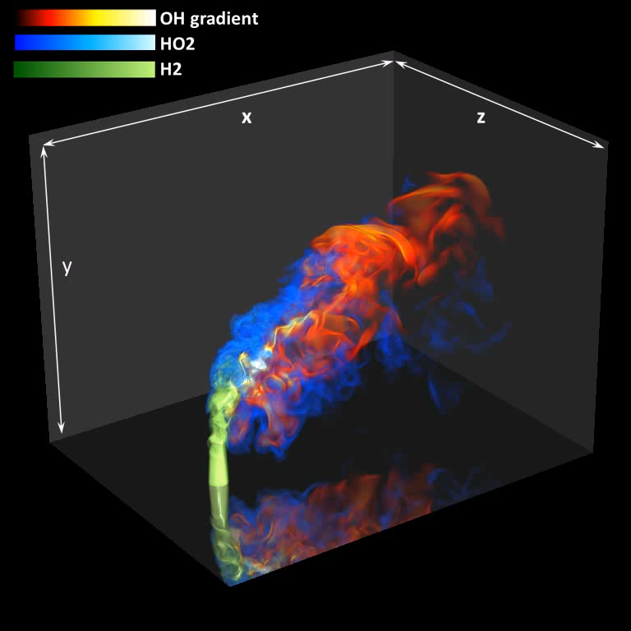

C++ is Important in Scientific Computing
Languages use at NERSC: 75% Fortran, 45% C/C++, 10% Python with C++ at least as important as C
DOE’s Exascale Co-Design Centers
ExaCT: Combustion simulation (uniform and adaptive mesh)
ExMatEx: Materials (multiple codes)
CESAR: Nuclear engineering (structures, fluids, transport)
NNSA Center: umbrella for 3 labs
“Proxy apps” to represent them
10 codes
4 in C++

Slide 134
UPC++: PGAS with Enhancements
Global address space
Function shipping across nodes
Multidimensional arrays
Local task queue
Multi-threading option
Private address space

Slide 135



A “Compiler-Free” Approach for PGAS
Leverage the C++ standard and compilers
Implement UPC++ as a C++ template library
C++ templates can be used as a mini-language to extend the C++ grammar
New features in C++ 11 makes UPC++ more powerful
E.g., async, auto type inference, lambda functions
C++ 11 is well-supported by major compilers
Notes:
CXX11 support in compilers: http://wiki.apache.org/stdcxx/C++0xCompilerSupport

Slide 136
UPC++ Software Stack
C/C++ Apps
UPC Apps
UPC++ Template Header Files
UPC Compiler
C++ Compiler
C11 standard: 701 pages
C++11 standard: 1334 pages
UPC Runtime
UPC++ Runtime
GASNet Communication Library
Network Drivers and OS Libraries

Slide 137
UPC++ Introduction
UPC++ “Language” (no compiler involved)
Shared variable
shared_var<int> s; // int in the shared space
Global pointers (to remote data)
global_ptr<LLNode> g; // pointer to shared space
Shared arrays
shared_array<int> sa(8); // array in shared space
Locks
shared_lock l; // lock in shared space
Default execution model is SPMD, but with optional async
async(place)(Function f, T1 arg1,…);
wait(); // other side does poll()

Slide 138
UPC++ Translation Example
shared_array <int, 1> sa(100);
sa[0] = 1; // “[]” and “=” overloaded
C++ Compiler
tmp_ref = sa.operator [] (0); tmp_ref.operator = (1);
UPC++ Runtime
Yes
Is tmp_ref local?
No
Local Access
Remote Access

Slide 139
Dynamic Global Memory Management
Global address space pointers (pointer-to-shared)
global_ptr<data_type> ptr;
Dynamic shared memory allocation
global_ptr<T> allocate<T>(uint32_t where,
size_t count);
void deallocate(global_ptr<T> ptr);
Example: allocate space for 512 integers on rank 2
global_ptr<int> p = allocate<int>(2, 512);
Remote memory allocation is not available in MPI-3, UPC or SHMEM.

Slide 140
Optimization Opportunities for Async_copy
upcxx::async_copy<T>(global_ptr<T> src,
global_ptr<T> dst,
size_t count);
Template specialization plus runtime compilation may translate this into a few load and store instructions!
This would be very difficult to do with a heavy-weight MPI API
MPI_Put(origin_addr, origin_count, origin_datatype, target_rank, target_disp, target_count, target_datatype, win)

Slide 141
One-Sided Data Transfer Functions
// Copy count elements of T from src to dst upcxx::copy<T>(global_ptr<T> src, global_ptr<T> dst,
size_t count);
// Non-blocking version of copy
upcxx::async_copy<T>(global_ptr<T> src,
global_ptr<T> dst,
size_t count);
// Synchronize all previous asyncs
upcxx::async_wait();
Similar to upc_memcpy_nb extension in UPC 1.3

Slide 142
UPC++ Equivalents for UPC Users
 | UPC | UPC++
Num. of threads | THREADS | THREADS
My ID | MYTHREAD | MYTHREAD
Shared variable | shared Type s | shared_var<Type> s
Shared array | shared [BS] Type A[sz] | shared_array<Type, BS> A(sz)
Pointer-to-shared | shared Type *pts | global_ptr<Type> pts
Dynamic memory allocation | shared void * upc_alloc(nbytes) | global_ptr<Type> allocate<Type>(place, count)
Bulk data transfer | upc_memcpy(dst, src, nbytes); | copy<Type>(src, dst, count);
Affinity query | upc_threadof(ptr) | global_ptr.where()
Synchronization | upc_lock_t | shared_lock
 | upc_barrier | barrier()
Homework: how to translate upc_forall?

Slide 143
Asynchronous Task Execution
C++ 11 async function
std::future<T> handle
= std::async(Function&& f, Args&&… args);
handle.wait();
UPC++ async function
// Remote Procedure Call
upcxx::async(place)(Function f, T1 arg1, T2 arg2,…);
upcxx::wait();
// Explicit task synchronization
upcxx::event e;
upcxx::async(place, &e)(Function f, T1 arg1, …);
e.wait();
Notes:
DEGAS async API is very similar to the standard library in C++ 11.
In addition, DEGAS async can specify the target place for executing the task.
template< class Function, class... Args>
std::future<typename std::result_of<Function(Args...)>::type>
async( Function&& f, Args&&... args );

Slide 144
Async Task Example
#include <upcxx.h>
#include <forkjoin.h> // using the fork-join execution model
void print_num(int num)
{
printf(“myid %u, arg: %d\n”, MYTHREAD, num);
}
int main(int argc, char **argv)
{
upcxx::range tg(1, THREADS, 2); // threads 1,3,5,…
// call a function on a group of remote processes
upcxx::async(tg)(print_num, 123);
upcxx::wait(); // wait for the remote tasks to complete
return 0;
}

Slide 145
Async with Lambda Function
// Thread 0 spawns async tasks
for (int i = 0; i < THREADS; i++) {
// spawn a task at place “i”
// the task is expressed by a lambda (anonymous) function
upcxx::async(i)([] (int num) { printf("num: %d\n”, num); },
1000+i); // argument to the λ function
upcxx::wait(); // wait for all tasks to finish
}
mpirun –n 4 ./test_async
Output:
num: 1000
num: 1001
num: 1002
num: 1003

Slide 146
X10-style Finish-Async Programming Idiom
using namespace upcxx;
// Thread 0 spawns async tasks
finish {
for (int i = 0; i < THREADS; i++) {
async(i)([] (int num)
{ printf("num: %d\n”, num); },
1000+i);
}
} // All async tasks are completed

Slide 147
How We Did It?
// finish { => macro expansion =>
for (f_scope _fs; _fs.done == 0; _fs.done = 1) {
// f_scope constructor call generated by compiler
// push the current scope in a stack
f_scope() { push_event(&_fs.e); }
for (int i = 0; i < THREADS; i++) {
// register the async with the current scope
async(i, e = peek_event())(…);
}
// f_scope destructor call generated by compiler
~f_scope() { pop_event(); _fs.e.wait(); }
// All registered tasks are waited for completion
}
Leverage C++ Programming Idiom Resource Acquisition Is Initialization (RAII)

Slide 148
Random Access Benchmark (GUPS)
// shared uint64_t Table[TableSize]; in UPC
shared_array<uint64_t> Table(TableSize);
void RandomAccessUpdate()
{
uint64_t ran, i;
ran = starts(NUPDATE / THREADS * MYTHREAD);
for(i = MYTHREAD; i < NUPDATE; i += THREADS) {
ran = (ran << 1) ^ ((int64_t)ran < 0 ? POLY : 0);
Table[ran & (TableSize-1)] ^= ran;
}
}
Main
update
loop
Logical data layout
0
1
2
3
4
5
6
7
8
9
10
11
12
13
14
15
Physical data layout
Thread 0
0
4
8
12
Thread 1
1
5
9
13
Thread 2
2
6
10
14
Thread 3
3
7
11
15

Slide 149
Manycore - A Good Fit for PGAS
Core
Core
Core
Core
PCIe Client Logic
L2
L2
L2
L2
Thread 0
Thread 1
Thread 2
Thread 3
61 cores, 30MB aggregate L2
1TFlops, 352GB/s memory bw
Private Memory
Private Memory
Private Memory
Private Memory
MC
TD
TD
TD
TD
MC
MC
MC
Shared Memory
Core
Core
Core
Core
L2
L2
L2
L2
PGAS Abstraction
TD
TD
TD
TD
Block Diagram of the Intel Knights Corner (MIC) micro-architecture

Slide 150
GUPS Performance on MIC
Difference between UPC++ and UPC is only about 0.2 μs (~220 cycles)

Slide 151
GUPS Performance on BlueGene/Q
Difference is negligible at large scale

Slide 152
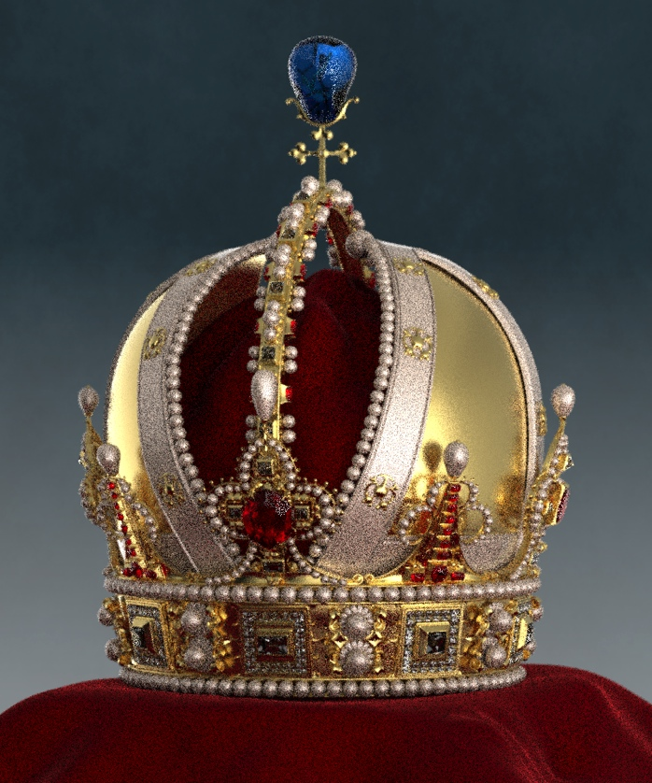

UPC++ Application: Embree
Low resolution
High resolution
Intel open-source ray tracing toolkit written in C++
Ported to UPC++ by Michael Driscoll
Performance scaled on Edison (Cray XC30)

Slide 153
Embree Performance on Edison
Hybrid UPC++ for internode communication and OpenMP within a NUMA node

Slide 154
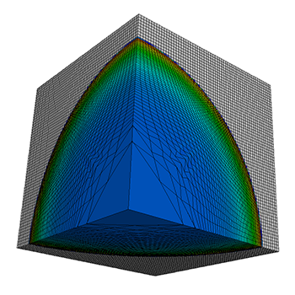
LULESH Proxy Application
Livermore Unstructured Lagrangian Explicit Shock Hydrodynamics
Proxy App for UHPC, ExMatEx, and LLNL ASC
Written in C++ with MPI, OpenMP, and CUDA versions
https://codesign.llnl.gov/lulesh.php
Notes:
Livermore Unstructured Lagrangian Explicit Shock Hydrodynamics
(LULESH)
The Shock Hydrodynamics Challenge Problem was defined and implemented by LLNL as one of five challenge problems in the DARPA UHPC program. Below we present a brief background to the shock hydro CP and provide links to a technical report (CP Specification) and several reference codes implementing the specification.
Computer simulations of a wide variety of science and engineering problems require modeling hydrodynamics, which describes the motion of materials relative to each other when subject to forces. Many important simulation problems involve complex multi-material systems that undergo large deformations. Examples include armor defense, penetration mechanics, blast effects, structural integrity, and conventional munitions such as shaped charges and explosively formed projectiles. Indeed, the original motivation to develop hydrodynamics simulation codes (hydrocodes) was to solve problems with defense applications.
Numerical algorithms used in hydrocodes present computational issues not found in other challenge problems. A typical hydrocode approximates the hydrodynamics equations discretely by partitioning the spatial problem domain into a collection of volumetric elements defined by a mesh. A node on the mesh is a point where mesh lines intersect. Finite difference equations that approximate differential operators in the equations couple variables on the mesh (e.g, at nodes and elements) via stencil operations. Other computations, involving material properties and equation of state, are interleaved with the stencil operations. The operations must be performed in a specific order for numerical accuracy and computational robustness.
Due to these computational characteristics, plus the importance of hydrocodes to DoD HPC efforts, typically 27% of total datacenter utilization, a hydrodynamics challenge problem is an important inclusion in a code suite used to evaluate UHPC architectures.

Slide 155
LULESH 3-D Data Partitioning

Slide 156
LULESH Communication Pattern
26 neighbors
6 faces
12 edges
8 corners
Cross-section view of the 3-D processor grid

Slide 157
Data Layout of Each Partition
x
Stride N²
Stride N²
Stride N
z
size: N³
y
3-D array A[x][y][z]
row-major storage
z index goes the fastest
Blue planes are contiguous
Green planes are stride-N² chunks
Red planes are stride-N elements

Slide 158
Convert MPI to UPC++
Pseudo code
// Post Non-blocking Recv
MPI_Irecv(RecvBuf1);
…
MPI_Irecv(RecvBufN);
Pack_Data_to_Buf();
// Post Non-bocking Send
MPI_Isend(SendBuf1);
…
MPI_Isend(SendBufN);
MPI_Wait();
…
Unpack_Data();
Pack_Data_to_Buf();
// Get neighbors’ RecvBuf addresses
// Post Non-blocking Copy
upcxx::async_copy(SendBuf1, RecvBuf1);
…
upcxx::async_copy(SendBufN, RecvBufN);
async_copy_fence();
…
Unpack_Data();

Slide 159
LULESH Performance on Cray XC30 (Edison)
Good
Take advantage of PGAS without the pain of adopting a new language

Slide 160
Example: Building A Task Graph
using namespace upcxx;
event e1, e2, e3;
t1
t2
e1
async(P1, &e1)(task1);
async(P2, &e1)(task2);
t4
t3
async_after(P3, &e1, &e2)(task3);
async(P4, &e2)(task4);
e2
async_after(P5, &e2, &e3)(task5);
async_after(P6, &e2, &e3)(task6);
t5
t6
async_wait(); // all tasks will be done
e3

Slide 161
Application: Full-Waveform Seismic Imaging
Method for developing models of earth structure, applicable to …
basic science: study of interior structure and composition
petroleum exploration and environmental monitoring
nuclear test-ban treaty verification
Model is trained to predict (via numerical simulation) seismograms recorded from real earthquakes or controlled sources
Training defines a non-linear regression problem, solved iteratively
Minimize:
Seismic
model
Observed waveforms
Predicted waveforms
Above: global full-waveform seismic model SEMum2 (French et al., 2013, Science)
Collaboration with Scott French et al, Berkeley Seismological Lab

Slide 162
Problem 2: Combining Data Sets
Merge measurement data into simulation and evaluate fit
Matrix is too large for single shared memory
Assembly: Strided writes into a global array
Goal is scalability in context of full code

Slide 163
Application: Full-Waveform Seismic Imaging
Performance of Convergent Matrix on Cray XC30
New implementation
Scales to larger dataset size and matrix dimension (currently ~2x in both)
Earlier runs that required 4+ phases now achieved in a single phase on the same aggregate number of cores and with ~40% wallclock time reduction
Notes:
Previous implementation
Matrix distribution implemented with MPI:
Some tasks responsible for matrix, others for generating updates
A single broker task collects updates and lazily Bcasts to matrix tasks
Cons: limited scaling (broker bottleneck), SPoF for memory exhaustion; matrix assembly often broken into phases (by dataset) and merged in post-processing
New implementation
Scales to larger dataset size and matrix dimension (currently ~2x in both)
Preliminary results
Modestly sized production runs at the moment
Largest: 3000+ cores on NERSC Edison
One UPC++ thread per NUMA domain
Remainder: OpenMP for physics computation, Pthreads + MPI for work distribution / scheduling
Strong scaling (fixed dataset size, fixed matrix size: 220k x 220k)
Relative parallel efficiencies over 85% up to 3072 cores (from <1000)
Earlier runs that required 4+ phases now achieved in a single phase on the same aggregate number of cores and with ~40% wallclock time reduction

Slide 164
UPC++ Arrays Based on Titanium
Titanium is a PGAS language based on Java
Line count comparison of Titanium and other languages:
AMR Chombo | C++/Fortran/MPI | Titanium
AMR data structures | 35000 | 2000
AMR operations | 6500 | 1200
Elliptic PDE Solver | 4200* | 1500
* Somewhat more functionality in PDE part of C++/Fortran code

Slide 165
UPC++ Multidimensional Arrays
True multidimensional arrays with sizes specified at runtime
Support subviews without copying (e.g. view of interior)
Can be created over any rectangular index space, with support for strides
Striding important for AMR and multigrid applications
Local-view representation makes locality explicit and allows arbitrarily complex distributions
Each rank creates its own piece of the global data structure
Allow fine-grained remote access as well as one-sided bulk copies

Slide 166
Overview of UPC++ Array Library
A point is an index, consisting of a tuple of integers
A rectangular domain is an index space, specified with a lower bound, upper bound, and optional stride
An array is defined over a rectangular domain and indexed with a point
One-sided copy operation copies all elements in the intersection of source and destination domains
point<2> lb = {{1, 1}}, ub = {{10, 20}};
rectdomain<2> r(lb, ub);
ndarray<double, 2> A(r); A[lb] = 3.14;
ndarray<double, 2, global> B = ...;
B.async_copy(A); // copy from A to B
async_wait(); // wait for copy completion
Notes:
Templates, operator overloading provide basic interface

Slide 167
Arrays in Adaptive Mesh Refinement
AMR starts with a coarse grid over the entire domain
Progressively finer AMR levels added as needed over subsets of the domain
Finer level composed of union of regular subgrids, but union itself is not regular
Individual subgrids can be represented with UPC++ arrays
Directory structure can be used to represent union of all subgrids

Slide 168
Example: Ghost Exchange in AMR
Proc 0
Proc 1
my_grids
all_grids
"ghost" cells
foreach (l, my_grids.domain())
foreach (a, all_grids.domain())
if (l != a)
my_grids[l].copy(all_grids[a].shrink(1));
Avoid null copies
Copy from interior of other grid
Can allocate arrays in a global index space
Let library compute intersections
Notes:
Red grid is only grid in my_grids on processor 0
Copies data from other interiors of other grids into own grid, on intersection.

Slide 169
NAS Benchmarks on One Node of Cray XC30
Notes:
On-node performance most important to compare, since it reflects indexing overhead and memory use

Slide 170
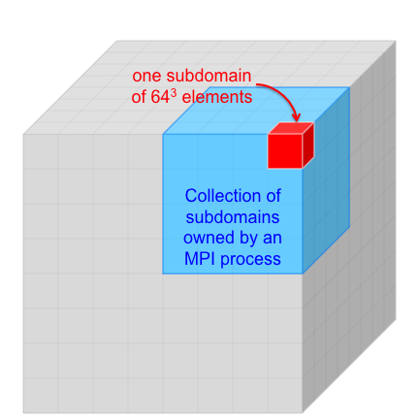
Case Study: miniGMG
Compact 3D geometric multigrid code
Can be used to evaluate performance bottlenecks in MG+Krylov methods and prototype new algorithms.
Highly instrumented for detailed timing analysis
Can be configured to proxy BoxLib AMR applications
Finite-volume (cell-centered) multigrid
7pt variable-coefficient Helmholtz operator (stencil)
Cubical domain decomposed into one 128³ subdomain per socket
Restriction terminated when subdomains are coarsened to 2³ (U-Cycle)
Gauss Seidel, Red-Black (“GSRB”) smoother
BiCGStab bottom solver (matrix is never explicitly formed)
Notes:
Slide from Sam Williams

Slide 171
miniGMG Communication Paradigms
One programming system w. three communication paradigms
Bulk version that uses manual packing/unpacking with one-sided puts
Fine-Grained version that does multiple one-sided puts of contiguous data
Array version that logically copies entire ghost zones, delegating actual procedure to array library
box 2
(remote)
box 3
(remote)
box 2
(remote)
box 3
(remote)
box 2
(remote)
box 3
(remote)
4
recv
buffer
3
2
recv
buffer
send
buffers
1
1
1
box 0
(local)
1
2
3
4
box 1
(remote)
box 0
(local)
2
box 1
(remote)
box 0
(local)
2
box 1
(remote)
i (unit stride)
i (unit stride)
i (unit stride)
i (unit stride)
i (unit stride)
i (unit stride)
Notes:
Bulk similar to MPI, but with one-sided instead of two-sided messages

Slide 172
miniGMG Results
Savings of ~200 lines of communication and setup code over Bulk and Fine-Grained versions
Performance results on IBM Blue Gene/Q
Currently working to bridge gap between Array and Bulk versions
Better
Better
Notes:
128^3/process on left, 64^3/process on right, so same amount of computation
Better productivity than fine-grained or bulk, performance close to bulk

Slide 173
Performance Results on Cray XC30
Fine-grained and array versions do much better with higher injection concurrency
Array version does not currently parallelize packing/unpacking, unlike bulk/MPI
Better
Better
Notes:
Using more processes automatically parallelizes packing/unpacking
Can further improve array version up to 20% by increasing AM medium limit

Slide 174
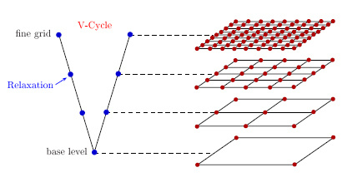
UPC++ HPGMG (work in progress)
Ghost Exchange
380 lines for comm. setup
same level
Restriction
330 lines for comm. setup
between two levels
finer level to coarser level, 1-1 or many-1, different owner
Interpolation
330 lines for comm. setup
between two levels
coarser level to finer level, 1-1, 1-many, different owner

Slide 175
HPGMG Performance (Box size = 2^7)
Though the naturally-grained version is about 3X slower but it saves over 1000 lines of very difficult code (testified by the original HPGMG developer) and saves auxiliary data structures for packing and unpacking.
Can Interconnect innovations bridge the performance gap between large and small messages?

Slide 176
PGAS Summary
Productivity through shared memory convenience
Especially for irregular communication
Ensure scalability through locality control
Expose lightweight RDMA communication
Possibly for “PGAS on a chip” systems
Minimally invasive, interoperable features
Open source and vendor (e.g., Cray) compilers
http://upc.lbl.gov
http://www.gccupc.org
https://bitbucket.org/upcxx

Slide 177
A Family of PGAS Languages
UPC based on C philosophy / history
http://upc-lang.org
Free open source compiler: http://upc.lbl.gov
Also a gcc variant: http://www.gccupc.org
Java dialect: Titanium
http://titanium.cs.berkeley.edu
Co-Array Fortran
Part of Stanford Fortran (subset of features)
CAF 2.0 from Rice: http://caf.rice.edu
Chapel from Cray (own base language better than Java)
http://chapel.cray.com (open source)
X10 from IBM also at Rice (Java, Scala,…)
http://www.research.ibm.com/x10/
Phalanx from Echelon projects at NVIDIA, LBNL,…
C++ PGAS languages with CUDA-like features for GPU clusters
Coming soon…. PGAS for Python, aka PyGAS

Slide 178
Productivity of the Titanium Language
Titanium is a PGAS language based on Java
Line count comparison of Titanium and other languages:
AMR Chombo | C++/Fortran/MPI | Titanium
AMR data structures | 35000 | 2000
AMR operations | 6500 | 1200
Elliptic PDE Solver | 4200* | 1500
* Somewhat more functionality in PDE part of C++/Fortran code

Slide 179
Productive Features in Titanium
UPC++ already provides many of Titanium’s productivity features
Basic high-level language features (e.g. object orientation, memory management)
Templates and operator overloading
SPMD execution model and PGAS memory model
Titanium features we want to implement in UPC++
True multidimensional rectangular arrays
Not distributed, but may be located on a remote thread
Hierarchical teams
Global object model (future work)

Slide 180
C and UPC Arrays
C/C++ arrays are limited in many ways
Multidimensional arrays must specify sizes of all but first dimension as compile-time constants
These sizes are part of the type, which makes it hard to write generic code
Easy to get view of contiguous subset of an array, but non-contiguous view must be handled manually
UPC shared arrays have their own limitations
Can only be distributed in one dimension
User must manually linearize a multidimensional array, use a directory structure, or both
Blocking factor must be a compile-time constant
upc_memcpy only supports contiguous source and destination

Slide 181
Example: Ghost Zones
Copying ghost zones requires manually packing/ unpacking elements at source/destination
In effect, turns one-sided operation into two-sided
Strided copy is not enough for ghost cell thickness > 1
Need “side factors” to specify how many elements to skip at end of each dimension

Slide 182
Multidimensional Arrays in Titanium
True multidimensional arrays
Supports subarrays without copies
Can refer to rows, columns, slabs, interior, boundary, etc.
Indexed by Points (tuples of ints)
Built on a rectangular set of Points, RectDomain
Points and RectDomains are built-in immutable classes, with useful literal syntax
Support for AMR and other grid computations
domain operations: intersection, shrink, border
Arrays are located on a single thread, but can be a remote thread
Notes:
Can have arrays of anything. Arrays of primitive types or immutables are best. Arrays of arrays are fast and useful (e.g. collection of grids on a level).

Slide 183
Points, RectDomains, Arrays in General
Points specified by a tuple of ints
RectDomains given by 3 points:
lower bound, upper bound (and optional stride)
Array declared by number of dimensions and type
Array created by passing RectDomain
Point<2> lb = [1, 1];
Point<2> ub = [10, 20];
RectDomain<2> r = [lb : ub];
double [2d] a;
a = new double [r];

Slide 184
Unordered Iteration
Motivation:
Memory hierarchy optimizations are essential
Compilers sometimes do these, but hard in general
Titanium has explicitly unordered iteration
Helps the compiler with analysis
Helps programmer avoid indexing details
foreach (p in r) { … A[p] … }
p is a Point (tuple of ints), can be used as array index
r is a RectDomain
Note: foreach is not a parallelism construct
Notes:
r is a previously declared RectDomain…
Much faster if r is a rectdomain, of course.

Slide 185
Simple Array Example
Matrix sum in Titanium
Point<2> lb = [1,1];
Point<2> ub = [10,20];
RectDomain<2> r = [lb:ub];
double [2d] a = new double [r];
double [2d] b = new double [1:10,1:20];
double [2d] c = new double [lb:ub:[1,1]];
for (int i = 1; i <= 10; i++)
for (int j = 1; j <= 20; j++)
c[i,j] = a[i,j] + b[i,j];
foreach (p in c.domain()) { c[p] = a[p] + b[p]; }
No array allocation here
Syntactic sugar
Optional stride
Equivalent loops

Slide 186
More Array Operations
Titanium arrays have a rich set of operations
None of these modify the original array, they just create another view of the data in that array
Most important array operation: one line copy between any two arrays with same element type and arity
dst.copy(src)
Copies all elements in intersection of source and destination domains
Both source and destination can be located on any thread
translate
restrict
slice (n dim to n-1)

Slide 187
Example: Setting Boundary Conditions
Proc 0
Proc 1
local_grids
"ghost" cells
all_grids
foreach (l in local_grids.domain()) {
foreach (a in all_grids.domain()) {
local_grids[l].copy(all_grids[a]);
}
}
Can allocate arrays in a global index space
Let compiler compute intersections
Notes:
Green domain is only grid in local_grids on processor 0
Copies data from other interiors of other grids into own grid, on intersection.
(should check to make sure you’re not just copying yourself)

Slide 188
Implementation of Titanium Arrays in UPC++
UPC++ implementation built using C++ templates and operator overloading
Template parameters specify arity and element type
Overload element access operator []
Macros provide simple syntax for domain/array literals
Titanium
[1, 3]
RectDomain<3> rd = [[1, 1, 1] : [3, 3, 3]];
int[3d] local arr = new int[[1, 1, 1] : [3, 3, 3]];
UPC++
POINT(1, 3)
rectdomain<3> rd = RECTDOMAIN((1, 1, 1), (3, 3, 3)); ndarray<int, 3> arr = ARRAY(int, ((1, 1, 1), (3, 3, 3)));

Slide 189
Foreach Implementation
Macros also allow definition of foreach loops
#define foreach(p, dom) \
foreach_(p, dom, UNIQUIFYN(foreach_ptr_, p))
#define foreach_(p, dom, ptr_) \
for (auto ptr_ = (dom).iter(); !ptr_.done; \
ptr_.done = true) \
for (auto p = ptr_.start(); ptr_.next(p);)

Slide 190
Preliminary Results
Currently have full implementation of Titanium-style domains and arrays in UPC++
Additionally have ported useful pieces of the Titanium library to UPC++
e.g. timers, higher-level collective operations
Four kernels ported from Titanium to UPC++
3D 7-point stencil, NAS conjugate gradient, Fourier transform, and multigrid
Minimal porting effort for these examples
Less than a day for each kernel
Array code only requires change in syntax
Most time spent porting Java features to C++
Larger applications will require global object model to be defined and implemented in UPC++

Slide 191
Performance Tuning
Since UPC++ is a library, cannot rely on compiler to optimize array accesses
Array library is very general, but generality results in overhead in simple cases
Preliminary approach is to provide template specializations that allow users to bypass inefficient, general code
In the future, we plan to explore automatic dynamic specialization
Potentially leverage SEJITS work at UCB

Slide 192
Example: CG SPMV
Unspecialized local SPMV in conjugate gradient kernel
void multiply(ndarray<double, 1> output,
ndarray<double, 1> input) {
double sum = 0;
foreach (i, lrowRectDomains.domain()) {
sum = 0;
foreach (j, lrowRectDomains[i]) {
sum += la[j] * input[lcolidx[j]];
}
output[i] = sum;
}
}
3x slower than hand-tuned code (sequential PGCC on Cray XE6)

Slide 193
Example: CG SPMV
Specialized local SPMV
void multiply(ndarray<double, 1, simple> output,
ndarray<double, 1, simple> input) {
double sum = 0;
foreach1 (i, lrowRectDomains.domain()) {
sum = 0;
foreach1 (j, lrowRectDomains[i]) {
sum += la[j] * input[lcolidx[j]];
}
output[i] = sum;
}
}
Comparable to hand-tuned code (sequential PGCC on Cray XE6)

Slide 194
Hierarchical Programming
Applications can reduce communication costs by adapting to machine hierarchy
Applications may also have inherent, algorithmic hierarchy
Recursive algorithms
Composition of multiple algorithms
Hierarchical division of data
Slow, avoid
0, 1, 2, 3, 4, 5
0
2
4
6
Fast, allow
1
3
5
7
0, 1, 2
3, 4, 5
0, 1
2
3, 4
5
0
1
3
4

Slide 195
Algorithm Example: Merge Sort
Task parallel
int[] mergeSort(int[] data) {
int len = data.length;
if (len < threshold)
return sequentialSort(data);
d1 = fork mergeSort(data[0:len/2-1]);
d2 = mergeSort(data[len/2:len-1]);
join d1;
return merge(d1, d2);
}
Cannot fork threads in SPMD
Must rewrite to execute over fixed set of threads

Slide 196
Algorithm Example: Merge Sort
SPMD
int[] mergeSort(int[] data, int[] ids) {
int len = data.length;
int threads = ids.length;
if (threads == 1) return sequentialSort(data);
if (myId in ids[0:threads/2-1])
d1 = mergeSort(data[0:len/2-1],
ids[0:threads/2-1]);
else
d2 = mergeSort(data[len/2:len-1],
ids[threads/2:threads-1]);
barrier(ids);
if (myId == ids[0]) return merge(d1, d2);
}
Team
Team Collective

Slide 197
Hierarchical Teams
Thread teams are basic units of cooperation
Groups of threads that cooperatively execute code
Collective operations over teams
Structured, hierarchical teams provide many benefits over flat teams
Expressive: match structure of algorithms, machines
Safe: eliminate many sources of deadlock
Composable: enable existing code to be composed without being rewritten to explicitly use teams
Efficient: allow users to take advantage of machine structure, resulting in performance gains

Slide 198
Team Data Structure
Threads comprise teams in tree-like structure
First-class object to allow easy creation and manipulation
Work in progress: add ability to automatically construct team hierarchy from machine structure
0, 1, 2, 3, 4, 5, 6, 7, 8, 9, 10, 11
0, 1, 2, 3
4, 5, 6, 7
8, 9, 10, 11
1, 3, 2
0
9, 8
10, 11

Slide 199
Team Usage Construct
Syntactic construct specifies that all enclosed operations are with respect to the given team
Collectives and constants such as MYTHREAD are with respect to currently scoped team
teamsplit(row_team) {
Reduce::add(mtmp, myresults, rpivot);
}
T1
T2
T3
0 | 1 | 2 | 3
4 | 5 | 6 | 7
8 | 9 | 10 | 11
=

Slide 200
Team Construct Implementation
teamsplit implemented exactly like finish
// teamsplit(row_team) { => macro expansion =>
for (ts_scope _ts(row_team); _ts.done == 0; _ts.done = 1) {
// ts_scope constructor call generated by compiler
// descend one level in team hierarchy
ts_scope(team &t) { descend_team(t->mychild()); }
// collective operation on current team
Reduce::add(mtmp, myresults, rpivot);
// ts_scope destructor call generated by compiler
~ts_scope() { ascend_team(); }
}
Leverage C++ Programming Idiom Resource Acquisition Is Initialization (RAII)

Slide 201
Merge Sort Team Hierarchy
Team hierarchy is binary tree
Trivial construction
Threads walk down to bottom of hierarchy, sort, then walk back up, merging along the way
0, 1, 2, 3, 4, 5
void divide_team(team &t) {
if (THREADS > 1) {
t.split(MYTHREAD % 2, MYTHREAD / 2);
teamsplit(t) {
divide_team(t.mychild());
}
}
}
0, 1, 2
3, 4, 5
0, 1
2
3, 4
5
0
1
3
4

Slide 202
Merge Sort Implementation
Control logic for sorting and merging
void sort_and_merge(team &t) {
if (THREADS == 1) {
allres[myidx] = sequential_sort(mydata);
} else {
teamsplit(t) {
sort_and_merge(t.mychild());
}
barrier();
if (MYTHREAD == 0) {
int other = myidx + t.mychild().size();
ndarray<int, 1> myres = allres[myidx];
ndarray<int, 1> otherres = allres[other];
ndarray<int, 1> newres = target(depth(t), myres, otherres);
allres[myidx] = merge(myres, otherres, newres);
}
}
}
Sort at bottom
Walk down team hierarchy
Walk up, merging along the way

Slide 203
Hierarchical Teams Results (Titanium)
Titanium has full hierarchical team implementation, including machine model
Hierarchical sort algorithm has both algorithmic hierarchy (merge sort) and machine-level hierarchy (mixed sample sort and merge sort)
GOOD

Slide 204
Summary
Many productive language features can be implemented in C++ without modifying the compiler
Macros and template metaprogramming provide a lot of power for extending the core language
Many Titanium applications can be ported to UPC++ with little effort
UPC++ can provide the same productivity gains as Titanium
However, analysis and optimization still an open question
Can we build a lightweight standalone analyzer/optimizer for UPC++?
Can we provide automatic specialization at runtime in C++?

Slide 205
Future Work
Arrays
Investigate dynamic optimization using just-in-time specialization
Design and build distributed array library on top of current library
Hierarchical teams
Design hierarchical machine model for UPC++
Add ability to query machine structure at runtime
Global object model
Explore template metaprogramming techniques for implementing a global object interface
Build a tool for generating global analogs from local class definitions

Slide 206
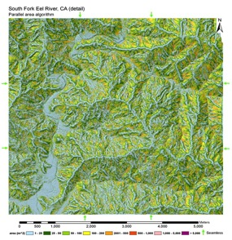
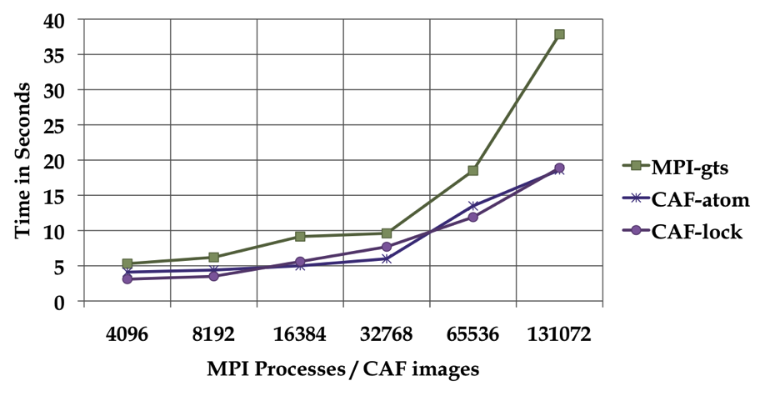
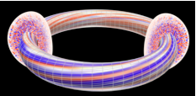
Application Work in PGAS
Network simulator in UPC (Steve Hofmeyr, LBNL)
Real-space multigrid (RMG) quantum mechanics (Shirley Moore, UTK)
Landscape analysis, i.e., “Contributing Area Estimation” in UPC (Brian Kazian, UCB)
GTS Shifter in CAF (Preissl, Wichmann,
Long, Shalf, Ethier,
Koniges, LBNL,
Cray, PPPL)

Slide 207
Two Distinct Parallel Programming Questions
What is the parallel control model?
What is the model for sharing/communication?
synchronization may be coupled (implicit) or separate (explicit)
SPMD “default” plus data parallelism through collectives and dynamic tasking within nodes or between nodes through libraries
data parallel
(singe thread of control)
dynamic
threads
single program
multiple data (SPMD)
receive
store
PGAS load/store with partitioning for locality, but need a “signaling store” for producer consumer parallelism
load
send
shared memory
message passing

Slide 208
PyGAS: Combine two popular ideas
Python
No. 6 Popular on http://langpop.com and extensive libraries, e.g., Numpy, Scipy, Matplotlib, NetworkX
10% of NERSC projects use Python
PGAS
Convenient data and object sharing
PyGAS : Objects can be shared via Proxies with operations intercepted and dispatched over the network:
Leveraging duck typing:
Proxies behave like original objects.
Many libraries will automatically work.
num = 1+2*j
= share(num, from=0)
print pxy.real # shared read
pxy.imag = 3 # shared write
print pxy.conjugate() # invoke
Notes:
Large user base and active community

Slide 209
Arrays in a Global Address Space
Key features of Titanium arrays
Generality: indices may start/end and any point
Domain calculus allow for slicing, subarray, transpose and other operations without data copies
Use domain calculus to identify ghosts and iterate:
foreach (p in gridA.shrink(1).domain()) ...
Array copies automatically work on intersection
gridB.copy(gridA.shrink(1));
intersection (copied area)
“restricted” (non-ghost) cells
Useful in grid computations including AMR
ghost cells
gridA
gridB
Joint work with Titanium group

Slide 210
Languages Support Helps Productivity
C++/Fortran/MPI AMR
Chombo package from LBNL
Bulk-synchronous comm:
Pack boundary data between procs
All optimizations done by programmer
Titanium AMR
Entirely in Titanium
Finer-grained communication
No explicit pack/unpack code
Automated in runtime system
General approach
Language allow programmer optimizations
Compiler/runtime does some automatically
Work by Tong Wen and Philip Colella; Communication optimizations joint with Jimmy Su

Slide 211
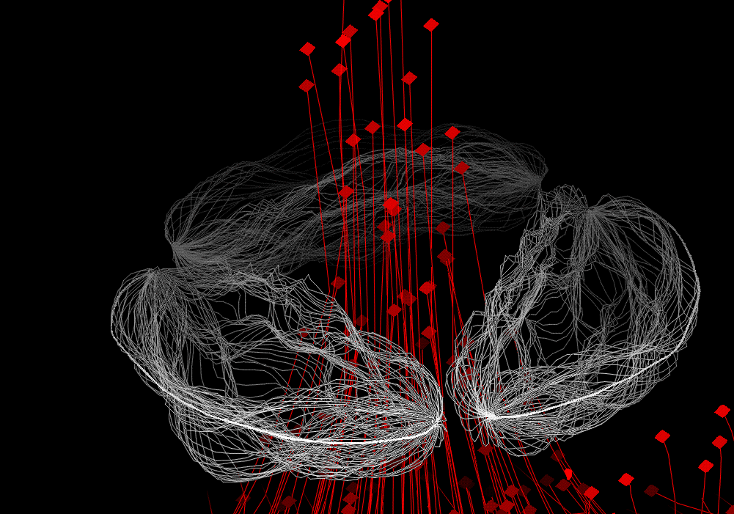
Particle/Mesh Method: Heart Simulation
Elastic structures in an incompressible fluid.
Blood flow, clotting, inner ear, embryo growth, …
Complicated parallelization
Particle/Mesh method, but “Particles” connected into materials (1D or 2D structures)
Communication patterns irregular between particles (structures) and mesh (fluid)
2D Dirac Delta Function
Code Size in Lines
Fortran | Titanium
8000 | 4000
Note: Fortran code is not parallel
Joint work with Ed Givelberg, Armando Solar-Lezama, Charlie Peskin, Dave McQueen
Notes:
Don’t say “toy language” example of applicatinon
64^3 was possible on Cray YMP, but 128^3 required for accurate model (would have taken 3 years).
Done on a Cray C90 -- 100x faster and 100x more memory
Until recently, limited to vector machines

Slide 212
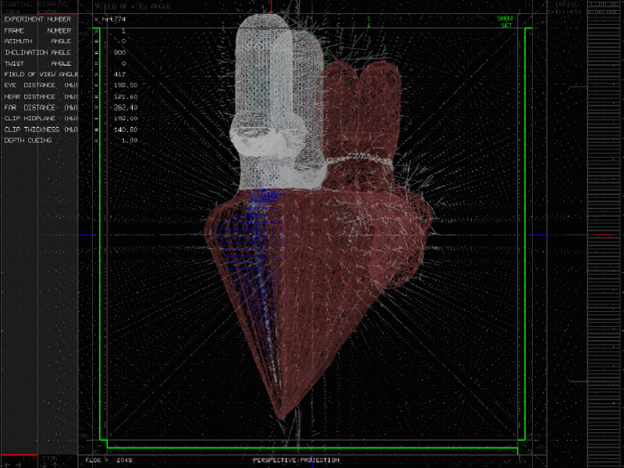

Slide 213
Compiler-free “UPC++” eases interoperability
global_array_t<int, 1> A(10); // shared [1] int A[10];
L-value reference (write/put)
A[1] = 1; // A[1] -> global_ref_t ref(A, 1); ref = 1;
R-value reference (read/get)
int n = A[1] + 1; // A[1] -> global_ref_t ref(A, 1); n = (int)ref + 1;

Slide 214
Hierarchical SPMD (demonstrated in Titanium)
Thread teams may execute distinct tasks
partition(T) { { model_fluid(); } { model_muscles(); } { model_electrical(); } }
Hierarchy for machine / tasks
Nearby: access shared data
Far away: copy data
Advantages:
Provable pointer types
Mixed data / task style
Lexical scope prevents some deadlocks
span 1
(core local)
1
span 2
(processor local)
A
4
B
2
3
span 3
(node local)
D
C
span 4
(global)

Slide 215
Hierarchical machines → Hierarchical programs
Single Program Multiple Data (SPMD) is too restrictive
Hierarchical memory model may be necessary (what to expose vs hide)
Two approaches to supporting the hierarchical control
0
2
4
6
1
0
3
5
7
1
2
3
Option 1: Dynamic parallelism creation
Recursively divide until… you run out of work (or hardware)
Runtime needs to match parallelism to hardware hierarchy
Option 2: Hierarchical SPMD with “Mix-ins”
Hardware threads can be grouped into units hierarchically
Add dynamic parallelism with voluntary tasking on a group
Add data parallelism with collectives on a group
Option 1 spreads threads, option 2 collecte them together

Slide 216
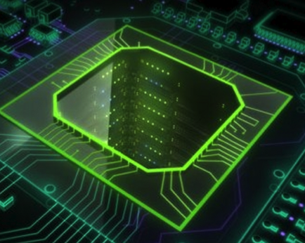
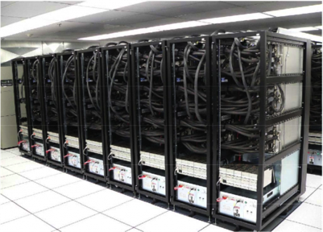
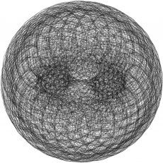
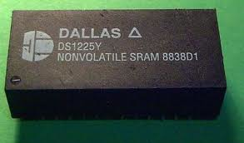
One-sided communication works everywhere
PGAS programming model
*p1 = *p2 + 1;
A[i] = B[i];
upc_memput(A,B,64);
It is implemented using one-sided communication: put/get
Support for one-sided communication (DMA) appears in:
Fast one-sided network communication (RDMA, Remote DMA)
Move data to/from accelerators
Move data to/from I/O system (Flash, disks,..)
Movement of data in/out of local-store (scratchpad) memory
Notes:
What is DMA? Use a title that is meaningful
Influenced MPI

Slide 217

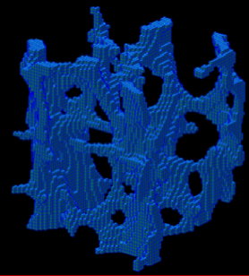
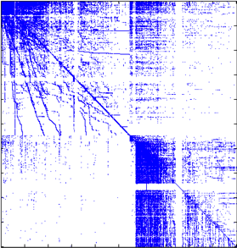
Vertical PGAS
New type of wide pointer?
Points to slow (offchip memory)
The type system could get unwieldy quickly
Private on-chip
l:
m:
Shared partitioned on-chip
x: 1
y:
x: 5
y:
x: 7
y: 0
Shared off-chip DRAM or NVRAM

Slide 218


HPC: From Vector Supercomputers to Massively Parallel Systems
Programmed by “annotating” serial programs
Programmed by completely rethinking algorithms and software for parallelism
25% industrial use 50%
Notes:
The effect of the “Killer Micros” on high end computing is most obvious from looking at data from the Top500 list, the fastest (reported) systems in the world
The systems went from dominated by fully customized vendor
20 years ago these HPC systems were dominated by vector supercomputers, while today they are almost 100% networks of X86 microprocessors
Hardware innovations for HPC have been the high speed interconnects that tie the processors today <click>
In this same period, the number of machines placed in industry went from about 25% to 50%, and we know this is underreported because HPC use is often considered a competitive advantage, so companies do not report <click>
This is an oversimplification, the vector supercomputers of the 80s and early 90s were programmed by annotating serial programs
Once machines were built as networks of microprocessors, they required substantial investments in algorithms and software

Slide 219
PGAS Languages
Global address space: thread may directly read/write remote data
Hides the distinction between shared/distributed memory
Partitioned: data is designated as local or global
Does not hide this: critical for locality and scaling
x: 1
y:
x: 5
y:
x: 7
y: 0
Global address space
l:
l:
l:
g:
g:
g:
p0
p1
pn
UPC, CAF, Titanium: Static parallelism (1 thread per proc)
Does not virtualize processors
X10, Chapel and Fortress: PGAS,but not static (dynamic threads)
Notes:
Too much time on this slide and next 3
Don’t talk about malloc
What about clusters of SMPs
Process, processor, thread
Too much talking relative to slide

Slide 220
A Brief History of Languages
When vector machines were king
Parallel “languages” were loop annotations (IVDEP)
Performance was fragile, but there was good user support
When SIMD machines were king
Data parallel languages popular and successful (CMF, *Lisp, C*, …)
Quite powerful: can handle irregular data (sparse mat-vec multiply)
Irregular computation is less clear (multi-physics, adaptive meshes, backtracking search, sparse matrix factorization)
When shared memory multiprocessors (SMPs) were king
Shared memory models, e.g., OpenMP, POSIX Threads, were popular
When clusters took over
Message Passing (MPI) became dominant
With multicore building blocks for clusters
Mixed MPI + OpenMP is the preferred choice

